Slide 1
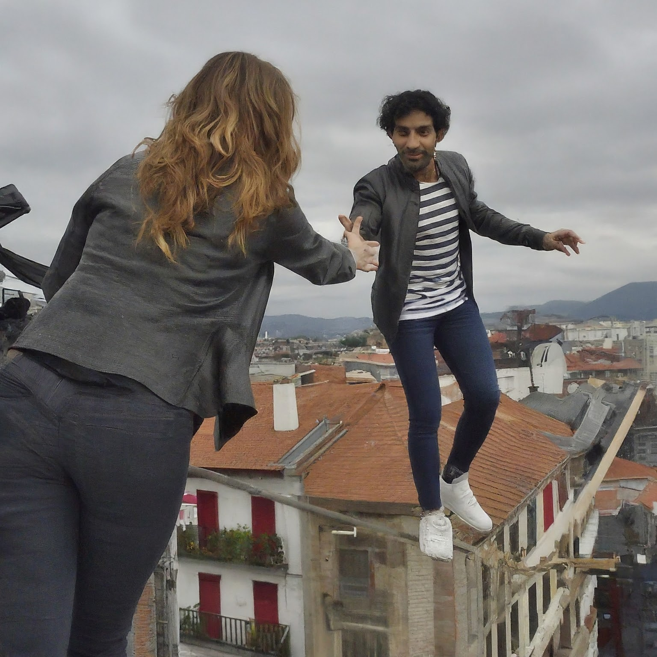
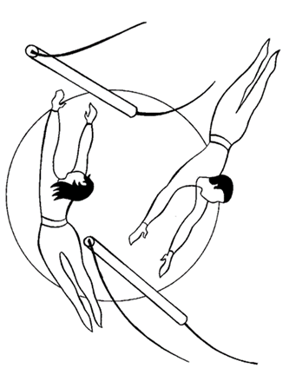

Trapezistak
Tightrope walkers

Slide 2


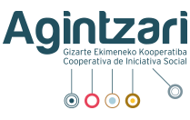
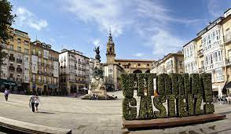
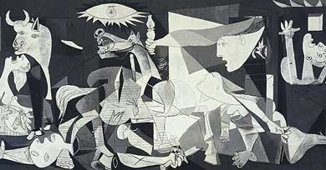
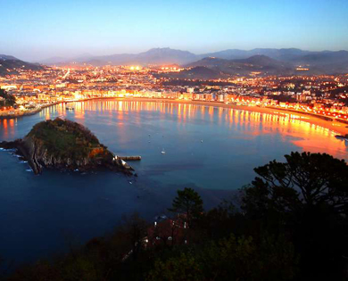
Who are we? Where do we come from?
Who we are and where we come from
The Basque Government (in Basque, Eusko Jaurlaritza) is the general administration of the Basque Country. An autonomous community with a wide range of exclusive competences, including taxation and among others, social services, family, minor and youth policies, as well as migration and the last phase of asylum.
It launched Trapezistak, in cooperation with Agintzari, provides funding, coordinates the develop of its integral approach and maintains a dialogue with the program stakeholders and social agents on migration and youth policies.
Agintzari (Basque for social promise) is a social initiative cooperative (non profit) whose activity began in 1977.
It works on the co-design, implementation, evaluation and impact assessment of Trapezistak inside a network of more than 20 third sector organizations cooperating with the Basque Government, and coordinated by three of them (Agintzari, Peñascal and Zabalduz).

Slide 3

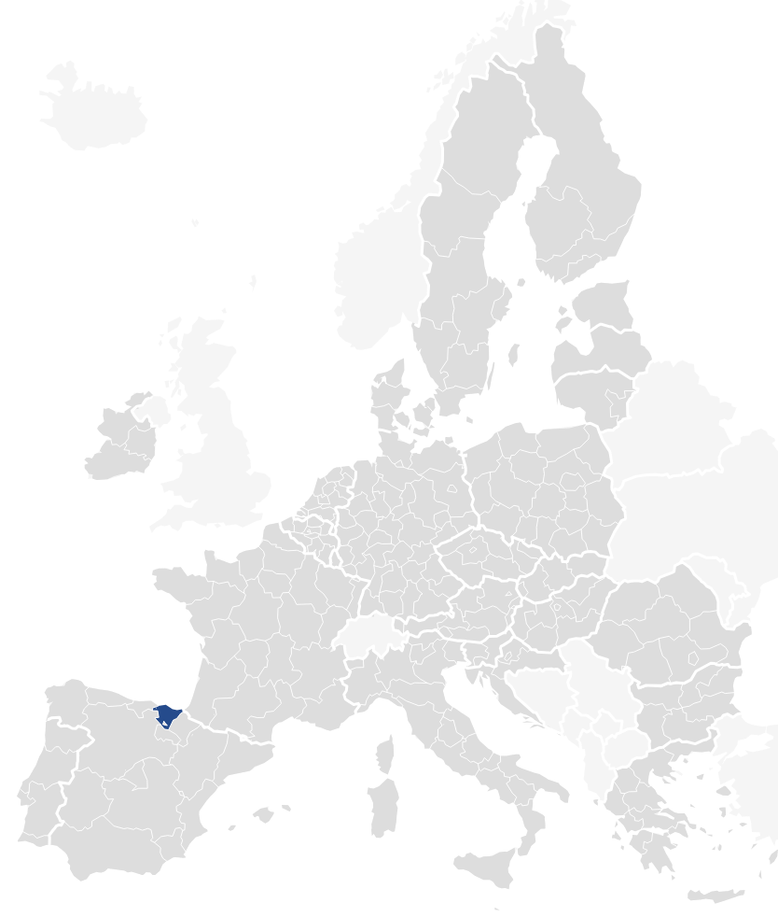

Who are we? Where do we come from?
Who we are and where we come from
Population = 2.196.745
Surface: 7.234 km2
Population density: 302/km2
Gini Index: 29,4% [EU27: 30,3%,2021)
Rate of people with foreign nationality (born abroad) =
9,3% (2023)
Predominance of Latin America (44%) and Maghreb countries (mainly Morocco; 11%)
Increased immigration influx + transitions to other European countries (ordinary / 3 crisis)
Young people (15-29) with foreign nationality in 2023 = 49.389 (the highest level since 2010 = 45.319)
Arrival of young people without family support (mostly Maghreb/Morocco.; Increasingly Western Africa), mostly to the three capitals
Unemployment rate = 7,9% (2024, 1st Tr.)
Youth unemployment rate (2023) = 12,6%
Increasing employment rate of young people from 16 up to 29 years old
High rate of employment after professional (83,2%) and university studies (90%). Jobs linked to studies (71,3%)-2022
GDP per Capita: EU: 100 / Euskadi (ES21): 108 / Spain: 85
Compensation of Employees D1/D2: EU27: 40.600 € / Euskadi: 41.200 € / Spain: 36.500 €
Demographic change: youth/old population rate baby boom impact on Basque society and social cohesion (life expectancy: 80,7; 2021)
Number of people aged 15-29 per 100 people aged 64 and over= 62%) & Population> 65 = 23% (2023)
SOURCES:
EUSTAT – BASQUE Statistics Institute – Demographics 2023)
GAZTE BEHATOKIA - Basque Youth Observatory - Youth profiles 2023
IKUSPEGI - Basque Immigration Observatory – Migration and asylym database
EUROSTAT – Annual national Accounts / Compensation Employees (NUTS II)

Slide 4

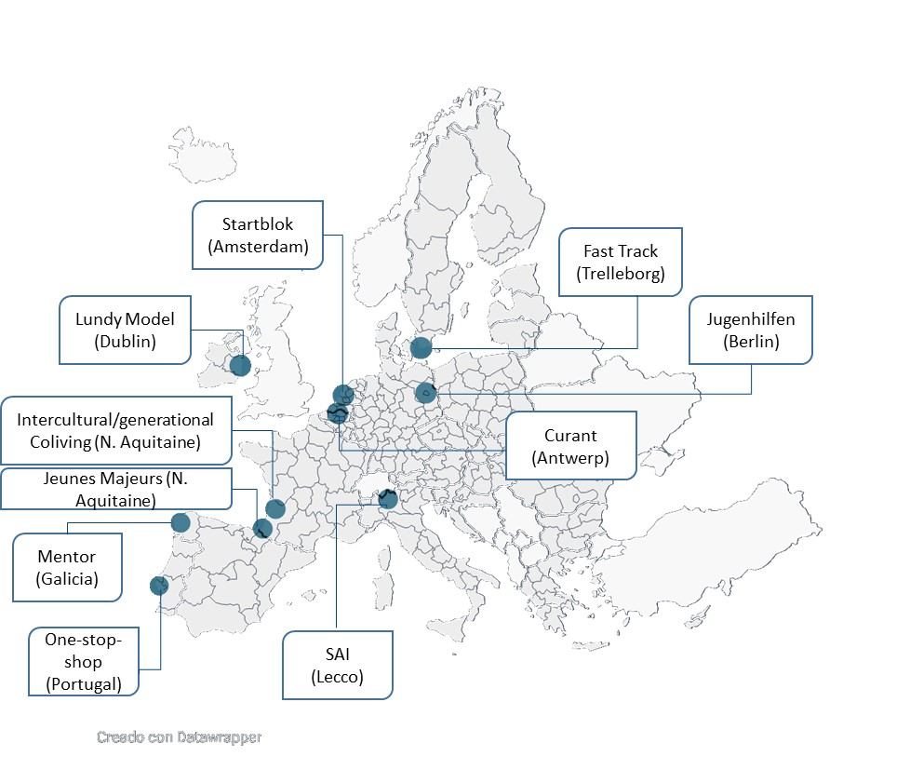



What is Trapezistak? Rationale
Trapezistak is a one-stop-shop integral model to promote successful transitions to adulthood of (migrant) youth in social disadvantage and without family references:
Framed in the Basque youth and migration policies, focused on rights and inclusion, is co-designed and developed from an inter-institutional perspective and in cooperation with the Social Third Sector.
Designed from the experience of the last pandemic for the experimentation of innovative, person-centered and multi-dimensional solutions, is inspired also by successful European practices adapted to our context
Specifically designed and strongly oriented to generate measurable impact (with an integrated monitoring and evolutive evaluation scheme) for subsequent replication and scaling up.

Slide 5




What is Trapezistak? Key figures
Results. What do figures say?
SCOPE
PROFILE
ROTATION
Men
From Morocco
Average age: 22.7
> 18 months in Euskadi
Urban settled
Registered + health card,
Unsolved administrative situation
606 persons
Age 18-25 (+2)
559 male (92,2%)
47 female (7,8%)
0 non-binary (0,0%)
242 (in)
206 (out)
Results: All goals covered (72% of 206)
Average time (if objectives are achieved): 374 days

Slide 6


Why Trapezistak? A Glocal approach
Global
Local
Law 2/2022 on Youth and Basque Strategy on Emancipation 2030 (including youth emancipation right-s and the Basque Youth Emancipation Network)
V Youth Plan (an integral policy on youth with a special focus on emancipation and vulnerability).
VI Intercultural Plan of citizenship, migration and asylum (to create conditions for social inclusion and the management of diversity).
Euskarri inter-institutional strategy for the social and labor inclusion of minors and young people in vulnerable situations (favoring an autonomous life project, with rights and duties).
Uztartu program for the prevention of violent radicalization (building a sense of community belonging).
Basque Social Pact for Migration (diversity and plurality, inclusive citizenship, migration as an opportunity)
Liquid Modernity (Bauman)
Yo-yo transitions (Otero)
Express transitions in vulnerable youth (Goyette)
More difficult transitions in vulnerable youth (Melendro)
Poorly executed transitions leading to social exclusion (Furlong and Carmel)
Need for integrated approaches (Du Boys-Reymond; Stein)
Lack of adequate generalized support for 18+ careleavers (European Commission)

Slide 7
How does Trapezistak work?
Youth and migration policies as the ordinary framework.
Emancipation right and rights (subjective or objective) linked to emancipation.
Need of specific emancipation policies (to leave parents home and consolidate it).
Emancipation and social inclusion as goals (enhancing autonomous living).
Transition to adulthood as a longer process.
Positive action inside a normalized emancipation network (gender, origin…)
Emancipation as result of several factors (employment, housing, income + capacities for autonomous living, cultural framework…)
Multidimensional (one-stop shop) and community approach (community model).
Public leadership and cooperation between sectors.
Focus on rights and duties.
Universal Declaration on Human Rights, European Convention on Human Rights, and the European Pillar of Social Rights as references.
Starting profiles and limits of the program.
Regulated access to citizenship / youth interventions with people who is in Euskadi.
Model of reception and social inclusion (vg: arrival resources oriented to agile integration with the participation of the community, and interculturality vs multiculturality or assimilation models).
Fundamentals of the program

Slide 8



How does Trapezistak work?
Coordination Team
ONE-STOP-SHOP
Multistakeholder activation
Person centered approach
Case Coordinators
Training / Labour intermediation
Social-educational intervention
Neighbourhood housing solutions
Intergenerational
Intercultural
Ex-care leavers
University students
Young workers
Etc
Support for administrative regularization
Housing solutions
Prof. Certificates Prof. Training College
Language
Training (VET)
Social/Personal Skills
Guaranteed Basic Income
Ordinary Market
Protected Market
Labour Intermediation
Social Capital (Social and Community Participation)

Slide 9
How does Trapezistak work?
Radar Ecosystem
Social Services
Third Sector
Training Centers
Sport / Leisure Clubs
Parishes Mosques
Others
Entry Assesment (Access Criteria)
15 technical criteria
Affirmative Action Women
Coordination Team
Yes
No
Signature of agreement (rights/duties)
Non-signature of agreement
Case Manager Assignment
Referral to the most pertinent protection system (community social services, specialized social services, mental health services) or regular employment and/or housing services, etc.).
Voluntary exit
Services
Non-compliance with agreement
Community
Evaluation
Organizations
Intervention
Trapezistak
Exit due to fulfillment of objectives

Slide 10
How does Trapezistak work?
WHAT FOR?
Ensure integrated approach (case/program)
Measure results (evolution/ impact)
Coordination Unit
Case Coordinator 1 (30)
Case Coordinator 2 (30)
Case Coordinator 3 (30)
Case Coordinator X (30)
ORGANIZATIONAL LEVEL
Social-educational
Org 1
Org 1
Org 1
Org 1
Org 1
Organization 1
Housing
Organization 1
Org 3
Organization 2
Org 3
Organization 1
Organization 2
Training / Labour
Org 2
Org 2
Org 2
Org 1
TIMELINE LEVEL
EVALUATION
PRE
M1
M2
[…]
MX
MONITORING
M1 M2 M3 M4 M5 M6 M7 M8 M9 M10 M11 M12 MX

Slide 11
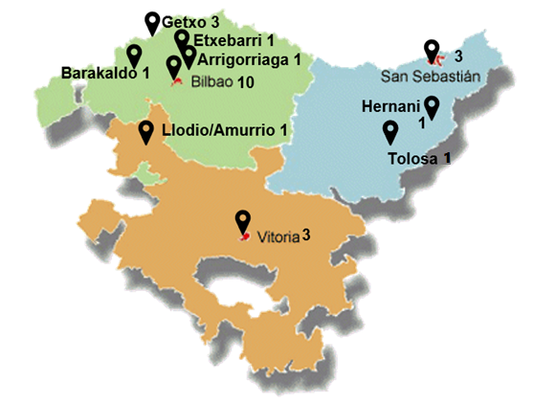




















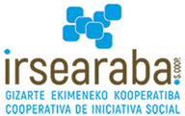



How does Trapezistak work?
A NETWORK OF MORE THAN 20 NON-PROFIT SOCIAL THIRD SECTOR ORGANIZATIONS
Each organization offers at least, neighborhood-based housing solutions and social-educational intervention and a personal reference to the young and the local community, enhance both capacities and opportunities. Some of them additionally offer training-labour intermediation services.
BIZKAIA
GIPUZKOA
This local network is one of the key factors of success. Agintzari, Peñascal and Zabalduz participate in this local network and also coordinate the program.
ARABA

Slide 12
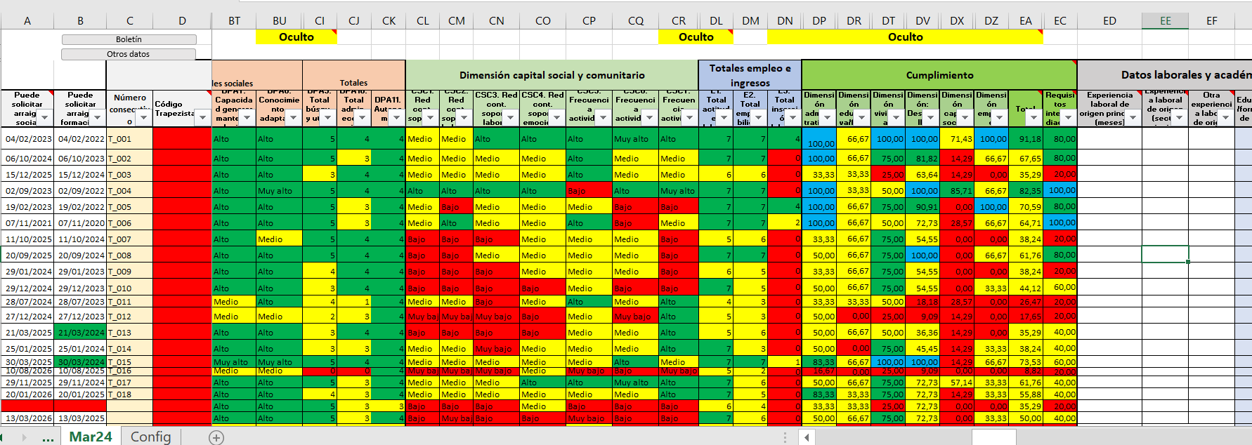

How do we measure the impact?
Integrated dual monitoring process: quantitative indicators (milestones/scales) and qualitative (evolutive evaluation model; Aguirre Lehendakaria Center / AC4-Columbia University).
Establishes the collection and organization of information (through sources of verification or evidence) as well as the flow of information between the different levels of decision making (strategy, coordination, intervention).
Organizes the information according to 6 areas / 36 indicators and establishes a common measurement criteria.
It uses a "traffic light" system to easily identify progress, setbacks, obstacles and milestones.
Combines strategic (Coordinating Team), technical (intervention team) and individual (the Trapezistak themselves) assessment.

Slide 13
How do we measure the impact?
Standardized indicators that are gathered using the same tools and scales (with prior training) by all organizations.
Monitored with the same periodicity - bimonthly - by all organizations (pre, during, post).
Evaluated from more than one point of view (different agents: technical, personnel, external) and incorporating the participation of the Trapezista himself.
Combining different methodologies: quantitative, qualitative and documentary (verification evidence).
Treated and analyzed from a triple perspective: individual, organization and program.
Covering soft and hard skills and 6 life dimensions for a comprehensive approach to the evaluation.
6
2
Access to standardized housing
Training,
employment and income
Personal, emotional and social skills and values
Language proficiency
6
Administrative status / rights & duties
Social and Community Participation
5
10
Impact Measurement
7
6 areas
36 indicators

Slide 14
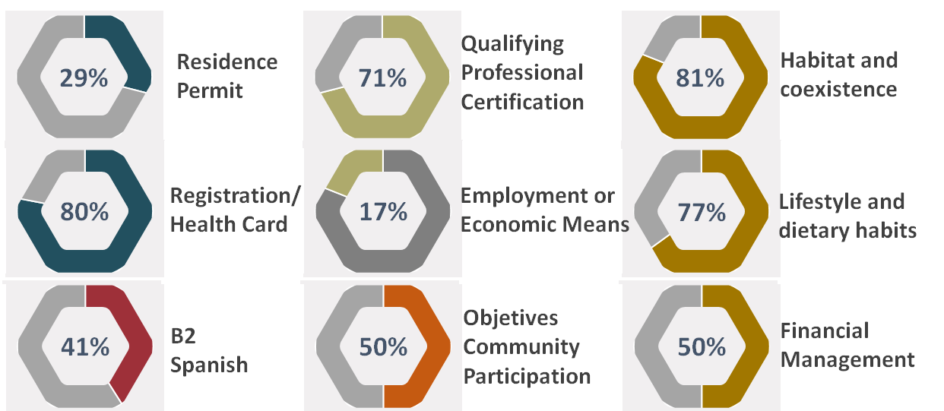
Results. What do figures say?
+ 18 months…
Qualifying Professional Certification
29%
Residence Permit
71%
81%
Habitat and coexistence
80%
Registration/ Health Card
17%
Employment or
Economic Means
77%
Lifestyle and dietary habits
41%
50%
Community Participation Objectives Met
50%
B2
Spanish
Financial Management

Slide 15
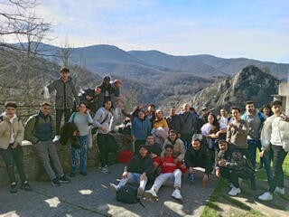
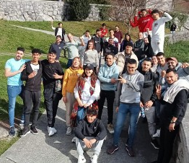
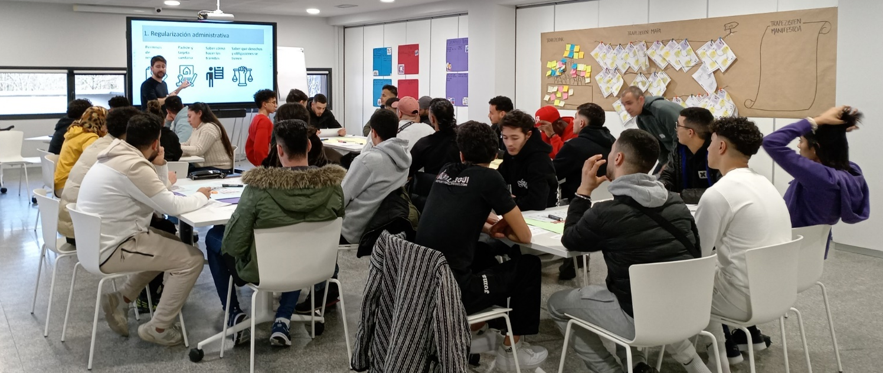
Results. What do the Trapezistak say?
When you get a
job your life is going
to change.
Because I will have
money, to help my family…
I will be able to improve
This is an experience in which we have learned to manage our doubts and look to the future. We are capable!
my life…
Having the
documents gives me
peace of mind. I can now
be hired by a company. I can
visit my relatives. Before
I was more worried. But
Mmm... I don't participate in many things because I'm always working...
now, I can move forward...

