Slide 1
Some misleading assumptions about school evaluation
reflection based on experience and literature

Slide 2
Selfevaluation
The Myth
Some misleading assumptions about school evaluation
SCHOOL SELF-EVALUATION DEVICE- The Myth
SCHOOL
BOARD
Services provided
Academic results
Projects
DIRECTOR
EvaluationTeam
SDPlan
Satisfaction
Etc. 1
Etc. 2

Slide 3
Sellfev picture
Some misleading assumptions about school evaluation
PROBABLE SCHOOL EVALUATION SCENARIO
Project C
SCHOOL BOARD
Partnership A
Academic results
DIRECTOR
SDPlan
Extra curricular activities
Parents’ representatives
Etc. 1
Etc. 2

Slide 4

Before was the chaos
Some misleading assumptions about school evaluation
First misleading assumption: before evaluation, school management was chaotic.
EVALUATION BIG BANG
RECALLING THE ORGANIZATIONAL THEORIES:
Schools as
organized anarchies;
loosely coupled systems.

Slide 5
Is evaluation a novelty ?
Some misleading assumptions about school evaluation
… evaluation has been with us for a long time. /…/ God knew the difference between good and evil but provided no indication how they can be distinguished.
Informal evaluation might argue that is better than formal evaluation, because we (Homo sapiens) as a species have survived. /…/ Luck was probably involved, but it is safe to say that survival meant making a lot of the right choices. And choosing is a matter of evaluation.
For formal evaluation to be better than informal, we need to be satisfied that it helps us to recognize goodness better.
in Stake, R. (2004), Standards-based Responsive Evaluation, SAGE

Slide 6
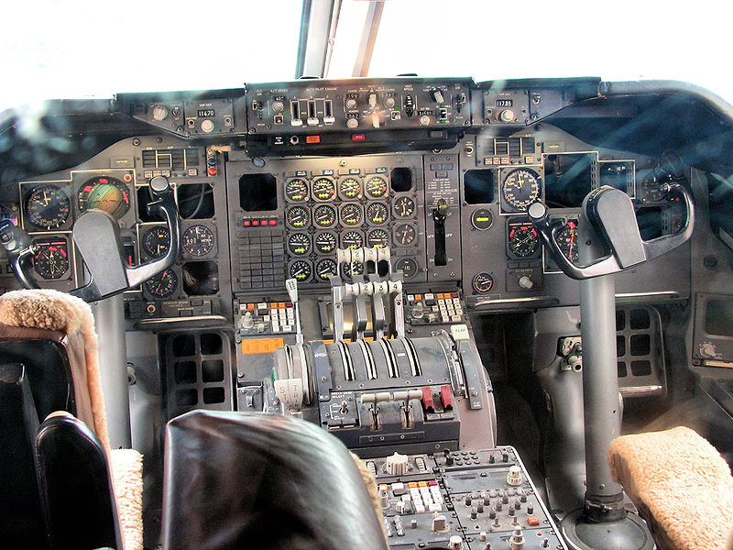
The leader & the cockpit
Some misleading assumptions about school evaluation
Second misleading assumption: although schools are complex organizations, evaluation is a question of leadership.
‘TECHNICAL’ INGREDIENTS
Applied Measurement
Building organizational capacity in evaluation
Involvement of Stakeholders
Participation and Collaboration
Principles
Program Implementation
Relevance and use
Reporting
Sampling
Standards
Use of Technology
…
(Inspired by Stufflebeam)

Slide 7
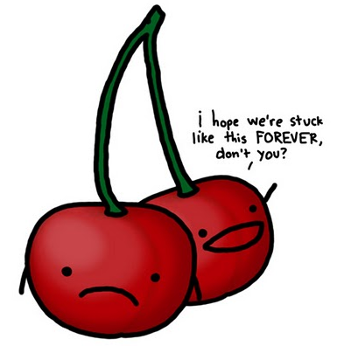
Make it Sustainable
Some misleading assumptions about school evaluation
Third misleading assumption: Once evaluation starts it will be forever.
SUSTAINABILITY FACTORS
The primary causes for evaluation
Shared understanding of ‘evaluation’
Pressure (social, government,…)
Available resources
Management of resources
Vision
Outputs
The use of evaluation
…. (what else?)

Slide 8
A clue for Sustainability
Some misleading assumptions about school evaluation
UTILIZATION FOCUSED EVALUATION
Utilization focused evaluation begins with the premise that evaluations should be judged by their utility and actual use.
Key components of the framework include that it is utilization-focused (designed specifically for the needs of its users), participatory (empowering the users at each step of the design and implementation process), theory-driven (employing logic modeling and consulting relevant literature for concept clarification), and consumer-based (directly addressing the needs of probable audiences of evaluation results)
Patton , Q. (2000), Utilization-Focused Evaluation

Slide 9

Effective evaluation
Some misleading assumptions about school evaluation
Fourth misleading assumption: Once evaluated, schools change and improve.
THEORY OF CHANGING
ORGANIZATIONAL LEARNING

Slide 10
Theory of Changing
Some misleading assumptions about school evaluation
THEORY OF CHANGING
To bring about more effective change, we need to be able to explain not only what causes it but how to influence those causes.
To implement and sustain programs successfully, we need better implementation plans;
To get better implementation plans, we need to know how to change hour planning and follow-through process;
To know how to change our planning process, we need to know how to produce better planners and implementers.
Fullan , M. (2001), The New Meaning of Educational Change

Slide 11
Organizational Learning
Some misleading assumptions about school evaluation
REVISITING ORGANIZATIONAL LEARNING
(Learning organization)
This ideal includes notions of organizational adaptability, flexibility, avoidance of stability traps, propensity to experiment, readiness to rethink means and ends, inquiry orientation, realization of human potential for learning in the service of organizational purposes, and creation of organizational settings as contexts for human development.
Argyris, C. (1999), On Organizational Learning

Slide 12
O. L.: not that easy!!
Some misleading assumptions about school evaluation
(just 2 warnings)
It is individuals acting as agents of organizations who produce the behaviour that leads to learning. Organizations can create conditions that may significantly influence what individuals frame as the problem, design as a solution and produce as action to solve a problem.
Organizational defensive routines are any action, policy, or practice that prevents organizational participants from experiencing embarrassment or threat, and, at the same time prevents them from discovering the causes of the embarrassment or threat.
Argyris, C. (1999), On Organizational Learning

Slide 13
Some misleading assumptions about school evaluation
Reflections
THE CONTEXT OF EXTERNAL EVALUATION OF SCHOOLS (sharing some personal reflections)
I am aware that evaluation - either external or self - is part of school everyday’s life.
School self-evaluation may look like a disorganized and incomplete puzzle. Very often, schools do not really know the value of their work and do not profit from it properly.
When telling schools how to improve, they will create defenses, by giving strong arguments justifying things as they are and thus preventing them from major changes.
13

Slide 14
Some misleading assumptions about school evaluation
Reflections
Praising today’s school self-evaluation does not guarantee tomorrows’ continuity. Usually sustainability is not part of the school evaluation agenda.
In order to change organizational routines, individuals have to change, myself included, in order to accept difference and to be critical enough about my own knowledge and about the accuracy of my tools.

Slide 15
THANK YOU FOR LISTENING

