Slide 1
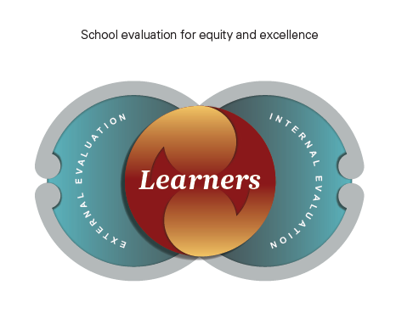

External and Internal School Evaluation: a New Zealand perspective
Sandra Collins
Senior Education Evaluator
Evaluation Services
Education Review Office
Presentation to
School Inspectorate
Training days
Bilbao, Basque Country
June 2018
Notes:
Zeelanda Berriko agurra (Greetings from New Zealand)
Eskerrik asko zure gonbidapenagatik (Thank you for your invitation)
Oso pozik nago hemen (I am very happy to be here)
Tēnā koutou, tēnā koutou, tēnā koutou katoa
Ngā mihi nui kia a koutou
It is a privilege and an honour to share with you today the work we are doing in the Education Review Office in New Zealand.

Slide 2
Overview of my presentation
2. ERO in the New Zealand education system
4.ERO’s approach to external evaluation in schools
6. Balancing internal and external evaluation
3. OECD review – a review of ERO’s evaluation indicators
1. New Zealand schools
5. Building internal evaluation capability
7. Evaluator training and development
8. Evaluator capabilities
9. Principles of practice
Notes:
In this presentation I want to provide you with an overview of where the Education Review Office sits in the education system in New Zealand and tell you a little bit about ERO and what we do. I will talk about ERO’s current approach to external evaluation in schools and the work we did to review our evaluation indicators. I will touch in the work we have done to support schools to undertake internal evaluation and the challenges we face in balancing internal and external evaluation. I know that you are interested in finding out about how we train our evaluators so I will give you an overview of our induction and development programme. I will conclude by sharing with you some recent work we have done to develop evaluator capabilities and principles of practice.

Slide 3
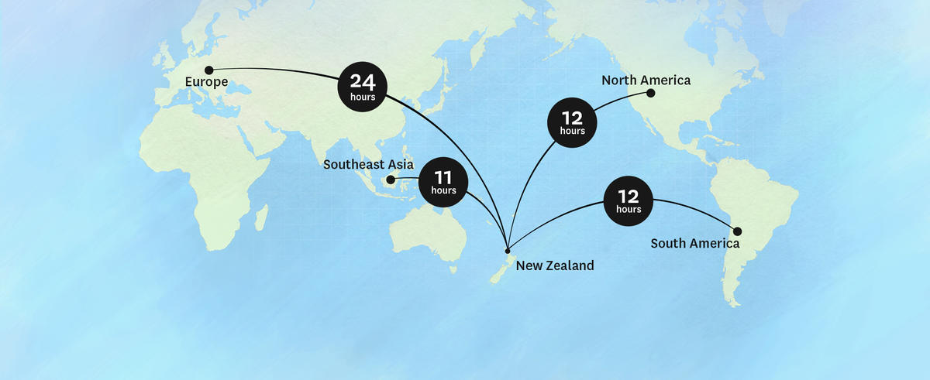

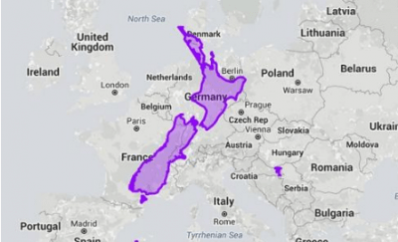
Notes:
Before I tell you a little bit about the Education Review Office and the New Zealand education system I thought I would share with you just where we sit in the world and my journey in getting to be with you today. The beautiful harbour in the photo on the right is our capital city Wellington and where I work and live.
New Zealand’s population is about four and a half million and we are a very geographically spread country with most of the population living in the North Island –particularly in Auckland, near the top of the North Island. Our communities are becoming increasingly diverse, particularly in our major cities.
Māori people are indigenous and Māori is an official language in New Zealand along with English and Sign Language.
The Treaty of Waitangi signed between the British Crown and Māori people in 1840 sets out rights for Māori in terms of partnership, protection and participation.

Slide 4
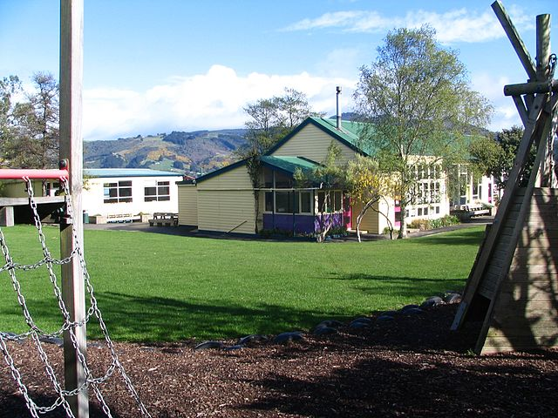
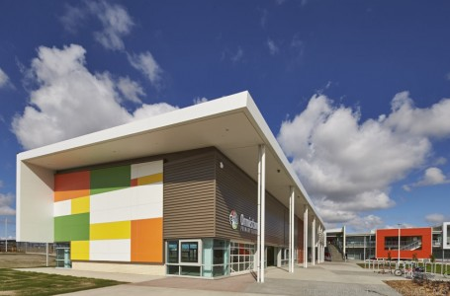
1. New Zealand schools - overview
Approximately 2400 schools
Most are state schools and government funded
Self managing with high level of autonomy
Most schools have between 100 and 2000 students
Our biggest challenges – disparity and within school variability
Notes:
We have approximately 2,400 schools and most children start school on their 5th birthday. Schooling is compulsory from age 6. Most of our schools are state schools and funded by government. We have many small rural schools.
There is a high degree of independence and autonomy of schools in our system, Principals are appointed and employed through elected school boards of trustees. This has implications for external evaluation and the need for a very strong oversight function.
We have a major issues in terms of disparity and within school variability our biggest challenge. We also have poor outcomes for some of our students, particularly those who are Māori or Pacific or from low socio-economic families. Māori students make up nearly 25 percent of the school student population and Pacific students about 10 percent of the population.

Slide 5
2. The New Zealand education system and the Education Review Office (ERO)
Parliament
Tertiary Education
Commission
Ministry of Education
Policy
Funding
Education NZ
Minister of Education
New Zealand Qualifications Authority
Education Council
Education Review Office
Schools and Early Learning Services
Parents and the community
Notes:
I want to begin by giving you a brief overview of the New Zealand education system and where the Education Review Office sits within that system. As you can see we are independent of the Ministry of Education and report directly to the Minister of Education. The education Review Office is referred to by its acronym ERO.

Slide 6
ERO’s mandate
An independent government department established in 1989
Statutory Powers of the Chief Review Officer (s325-328 Education Act, 1989)
Right to enter schools and early childhood services
Evaluate the performance of schools and early learning services and publicly report our findings
Designated Review Officers collect authentic, triangulated information in schools and services and verify policy implementation and quality
Notes:
ERO was established in 1989 as part of a substantial reform of the education system.
ERO has a statutory role in established in legislation.
This statutory role gives ERO right of entry into schools and early childhood services.
Review Officers have a designation that gives them powers of entry and inspection.
Our reporting is transparent and all ERO reports for early learning services and schools (and our national evaluation reports) are published on our website.

Slide 7
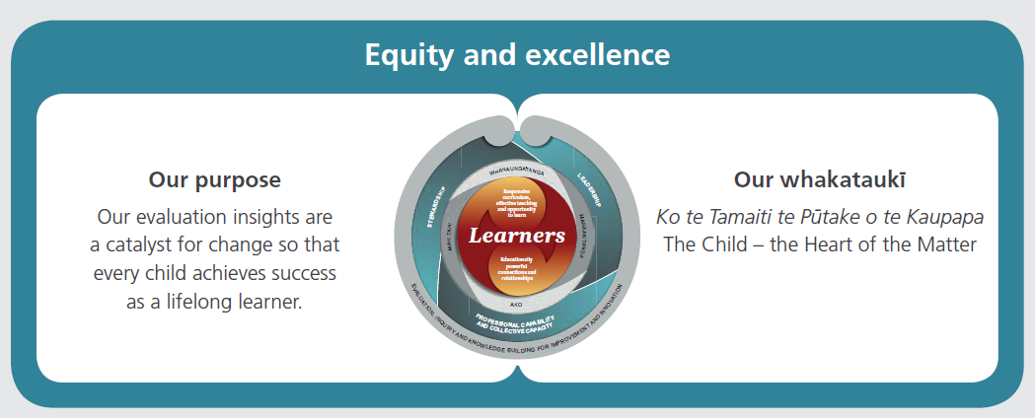
ERO – who we are and what we do
142 designated review staff
80% of staff are field reviewers
National office and 7 regional offices
650-840 school evaluations per year
1200-1460 early childhood evaluations
Up to 20 national evaluation reports produced each year
Notes:
Most of ERO’s staff are review officers located in our 7 regional offices.
I work in the team in ERO’s national office that is responsible for the national evaluation reports- system level reports on a range of topics.
I worked for 7 years as a review officer evaluating the performance of both schools and early learning services.

Slide 8
ERO’s dual purpose
Accountability
Improvement
Notes:
An integral part of ERO’s external evaluation role is the dual purpose and focus we have on both accountability and improvement. This dual purpose means that ERO evaluator (review officers) undertake external evaluations with both of these purposes in mind. They need to be responsive to each school’s context and the findings that emerge, balancing both of these aspects.

Slide 9
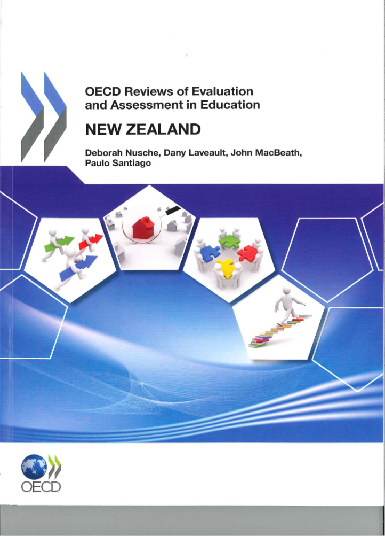
3. Reviewing ERO’s school evaluation indicators
OECD review- trigger for change
Notes:
The work ERO has undertaken to revise its evaluation indicators and increase the focus on internal evaluation has been driven by this OECD review (and ERO’s ongoing programme of reviewing its approach to reviews).
The OECD review on New Zealand’s evaluation and assessment framework made two key recommendations:
ERO should build on the indicator framework to consolidate understanding.
ERO and the Ministry of Education should work together to focus on internal evaluation, specifically to enhance support structures, and to make sure that it addresses the breadth of the curriculum.

Slide 10


School evaluation indicators
conceptual framework
Notes:
In 2014/2015 ERO reviewed its School Evaluation indicators using an academic expert panel to critique the existing indicators and present the evidence for a much reduced set of indicators about ‘what matters most’ in schooling.
The conceptual framework for the indicators includes six domains derived from the evidence examined and critiqued in the indicator development project.
At the heart of this framework are all learners and the outcomes we hold for them. We know from the evidence that responsive curriculum, effective teaching and opportunity to learn along with educationally powerful connections and relationships are the two domains of practice that matter most in achieving those outcomes.
The other domains of stewardship, leadership, professional capability and collective capacity and evaluation, inquiry and knowledge building for improvement and innovation are critical to learner success.

Slide 11
Outcome indicators
“confident, connected, actively involved, lifelong learners”
Confident in their identity, language and culture as citizens of Aotearoa New Zealand
Socially and emotionally competent, resilient and optimistic about the future
A successful lifelong learner
Participates and contributes confidently in a range of contexts - cultural, local, national and global
Notes:
The outcome indicators are derived from the valued outcomes in the curriculum frameworks used in our schools - The New Zealand Curriculum used in English-medium schools and Te Marautanga o Aotearoa used in Māori medium schools,

Slide 12
Domains - what matters most Process indicators
stewardship of the school
leadership of conditions for equity and excellence
educationally powerful connections and relationships
responsive curriculum, effective teaching and opportunity to learn
professional capability and collective capacity
improvement and innovation through evaluation, inquiry and knowledge building
http://www.ero.govt.nz/publications/school-evaluation-indicators/indicators-background-papers/
Notes:
The process indicators are organised in terms of six key domains found to influence school effectiveness and student outcomes. They are drawn from research and evaluation evidence linked to outcomes and are illustrated by examples of effective practice. These are the conditions that support ongoing improvement and learner success.
The papers from the academic expert panel members can be accessed on ERO’s website.

Slide 13
Domain 4: Responsive curriculum, effective teaching and opportunity to learn (an example)
Evaluation indicator | Effective practice
Students have effective, sufficient and equitable opportunities to learn. | The learning environment is managed in ways that support participation, engagement and agency in learning. Learning opportunities enable students to relate new information to prior knowledge and to modify existing conceptions as necessary. Students experience an environment in which it is safe to take risks and errors are regarded as opportunities for learning. Participation in effective heterogeneous (mixed ability) group activities provides students with cognitive challenge and opportunities for deep learning.
Notes:
This is an example from the indicators using Domain 4 – Responsive curriculum, effective teaching and opportunity to learn.
This is one of the 26 indicators and some of the effective practice examples that show what the indicator might look like in practice that is effective.

Slide 14


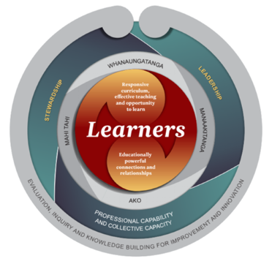
4. ERO’s current approach to school external evaluation
ERO’s external evaluation focus
Learner outcomes
The conditions that contribute to learner success
Notes:
As noted earlier in my presentation, ERO has reviewed and refreshed its approach to external evaluation in schools. I want to talk about what that current approach looks like.
During ERO’s external evaluation we discuss with school leaders and the board of trustees how well their school is performing for its learners and what they want to achieve going forward.
We have two complementary dimensions to our evaluation focus:
Learner outcomes and the conditions that contribute to learner success. As you can see this focus aligns to our evaluation indicator framework.

Slide 15
ERO’s external evaluation will
Use a school’s evidence – from a range of sources and evaluation activities (triangulate)
Consider and seek further evidence when necessary
Analyse to unpack what the evidence shows- what is so?
Synthesise to decide what the evidence means – so what?
Develop emerging evaluation findings and discuss them with the school governance (board of trustees)
Write a report based on the evaluation judgements
Confirm the report with the board of trustees
Publish the confirmed report on the ERO website
Notes:
ERO’s external evaluation in a school starts with the school’s evidence from a range of sources and evaluation activities. ERO’s role is to use the school’s evidence to design the evaluation and develop lines of inquiry using the domains and indicators to both test evidence and guide the evaluation. Further evidence is gathered as needed to investigate specific domains in more depth with a focus on what supports and inhibits improvement and learner success. The evidence is analysed and synthesised iteratively by the evaluation team, with attention given to the sufficiency of evidence gathered. The evaluation indicators are used at this stage to test evaluator judgements. Involvement of senior leaders in the ongoing interpretation of evidence contributes to the validity, credibility and usefulness of findings. Emerging evaluation findings are shared with school leaders and trustees. A written report is drafted and shared with the school prior to confirmation and publishing on ERO’s website. I will talk in a bit more detail about the overall evaluation process later in my presentation.

Slide 16
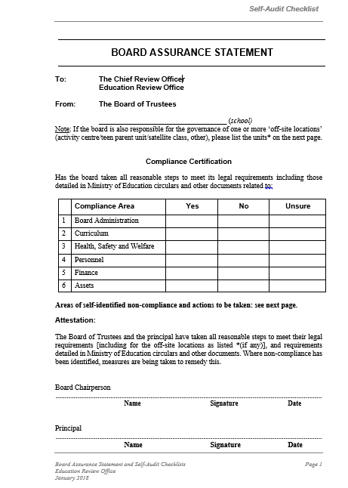
ERO’s evaluation also includes a focus on compliance with legislation
Board Assurance Statement (BAS) (can be downloaded from the ERO website)
The board chairperson and principal attest to compliance with legislative requirements.
ERO checks the BAS as part of preparing for the external evaluation.
There is an opportunity for ERO to discuss or clarify anything the board of trustees is not clear about.
Notes:
The accountability aspect of ERO’s external evaluation in school is based on a high trust approach. The school attests to compliance with legislative requirements in a Board Assurance Statement and the ERO team check the responses as part of the initial part of the evaluation.

Slide 17
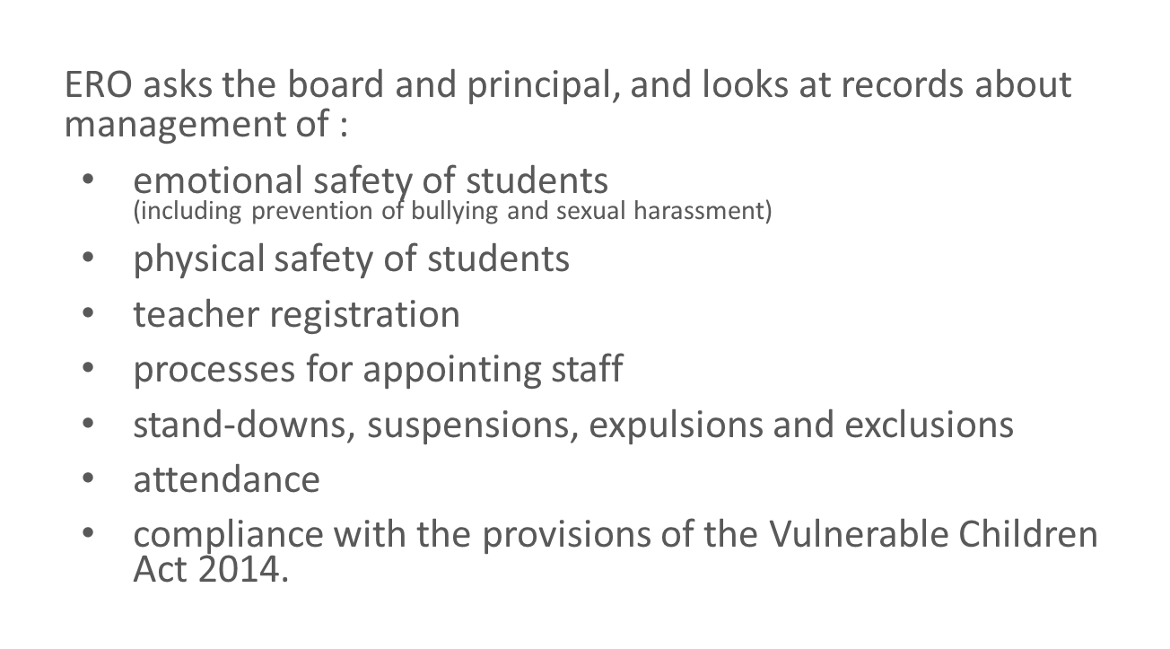
Compliance - student safety
Notes:
In every school evaluation ERO check the following aspects related to student safety starting with the Board Assurance Statement responses and then in discussion with the board and principal and verification in relevant school documentation.

Slide 18
ERO’s evaluation process
Set up Notification
School is due for an external evaluation based on previous evaluation
Scoping Evaluation design
Initial documentation
Previous report and reporting history
Onsite
Meetings with key personnel
Reporting
6-8weeks before external evaluation
Time allocated to evaluation – depends on size of school and number of evaluators in team
Email notification
Any complaints on file
System-level achievement and engagement data
Synthesis
Data gathering
Observations
Document analysis
Analysis
What is so?
So what?
Emerging findings
Draft report written
Peer review
Management review
Quality assurance
Draft report sent to school
Response from school
Report confirmed and published on ERO’s website
Decision about timing of next review made for inclusion in the report
Post review questionnaire sent to schools
Notes:
This slide outlines the evaluation process from initial set up and notification to the publishing of the final evaluation report. We schedule the evaluation based on the outcome of the previous evaluation. Schools are notified by email approximately 6-8 weeks before the evaluation team visits the school. The amount of time allocated to an evaluation is based on school size and the size of the evaluation team.
We do ask schools for some information before the evaluation starts onsite.
This includes their school charter and associated planning, their latest annual report, and plans for staff professional learning and development. We also ask for the two most recent reports to the board about students’ progress and achievement and evidence of whole school improvement over successive years. As mentioned already we also ask for the Board Assurance Statement. The ERO team accesses the pervious report and looks at the school’s reporting history along with checking if there are any complaints on the school’s file. ERO has access to information about student achievement and engagement held at a system level- particularly in our secondary schools. I have already talked about the evidence gathering ERO does and this is largely through meetings, document analysis and observations (mostly used for triangulation purposes).
A draft report based on evaluation findings is written and is peer and management reviewed prior to it being sent to the school for feedback. The peer review process checks that the report meets ERO’s quality standards including that we have the evidence for the judgements in the report.
The confirmed report is publically available on ERO’s website. ERO follows up with a post review questionnaire to provide the leaders and board with the opportunity to give ERO feedback on theirexperience of the external evaluation.

Slide 19
Deciding the timing of the next review
http://www.ero.govt.nz/assets/Uploads/Decision-Next-ERO-Evaluation-SCHOOLS-January-2018.pdf
Notes:
Each school’s ERO report will signal the timing of their next external evaluation.
These are typically over a period of one-to-two years, within three years or within four-to-five years.
Decisions about the timing of the next evaluation are based on ERO’s judgement about each school’s capability to sustain and extend improvements in teaching and learning. We have criteria that we use to make that decision. The criteria are available on ERO’s website.
ERO will signal the need for additional support for a school where we consider this is needed.

Slide 20
Timing of next review -2017 data
Notes:
This is our return time data for 2017. As you can see, most of our schools are in the 3 year return category with about 1 in 5 having their next ERO evaluation within 4-5 years and 8% having their next review within 1-2 years.
The challenge for ERO is that the majority of schools are on a 3 year evaluation cycle and we need to influence improvement in these schools through external evaluation so they move from being ‘good enough to great’.
We need to think about how we develop an approach which recognises or differentiates performance in these schools.

Slide 21




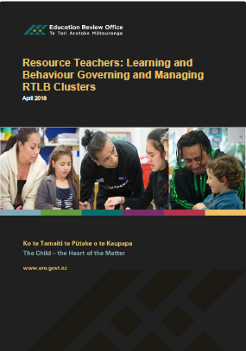
System-level evaluations National evaluation reports (NETs)
Notes:
ERO’s external evaluation process also includes a National Evaluation Topic. In every individual school external evaluation ERO’s gathers information for the current national evaluation topic. The information gathered is analysed in our Evaluation services team by evaluators and senior education evaluators such as myself. ERO’s national evaluation reports cover a range of topics and include good practice reports as well as reports that synthesise a group of national report findings on a particular topic. On this slide I have three of our more recent reports.
Some of our system-level reports are based on data gathered as part of a special evaluation project such as the recent Resource Teachers: Learning and Behaviour report.
Our system-level reports inform policy development in the Ministry of Education or other government agencies and also provide a resource for schools to draw on in their internal evaluation activities. They also promote timely debate on topics of interest.

Slide 22
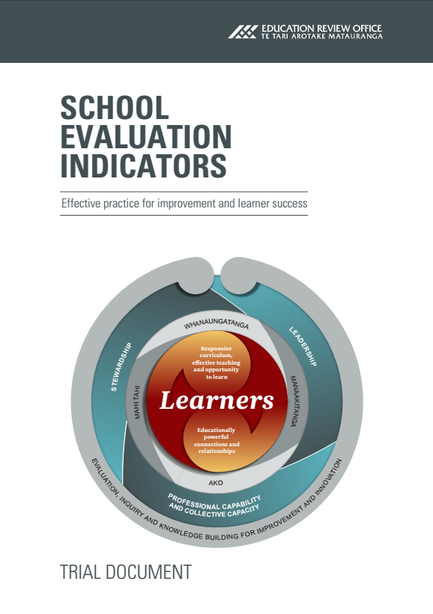


5. Building internal evaluation capability
School Evaluation Indicators: Effective Practice for Improvement and Learner Success
Effective School Evaluation How to do and use
internal evaluation for improvement
Effective School Evaluation for Improvement Good Practice Report
http://www.ero.govt.nz/videos/
www.ero.govt.nz
Notes:
Alongside the development of the indicators we undertook a case study project to better understand how high performing schools improved- how they knew what to improve and how to improve.
From that case study work we published two reports- a good practice report and an internal evaluation resource for school (jointly published by the Ministry of education and ERO).
These documents can be accessed from ERO’s website along with videos that show the indicators in action.

Slide 23
Domain 6: Evaluation, inquiry and knowledge building for improvement and innovation
Indicators
Coherent organisational conditions promote evaluation, inquiry and knowledge building.
Collective capacity to do and use evaluation, inquiry and knowledge building sustains improvement and innovation.
Evaluation, inquiry and knowledge building capability facilitates engagement with external evaluation and the wider education community.
Notes:
The sixth domain is the engine that drives improvement. The indicators listed here highlight the relationship between organisational conditions and the capacity to do and use evaluation for improvement and how these influence engagement with external evaluation.
The indicators are designed to make it easier for internal and external evaluation to talk to each other. They provide a common language for ERO and schools as part of the external evaluation process.

Slide 24
6. Balancing internal and external evaluation
An evaluation approach that balances ERO’s external evaluation with internal evaluation, according to each school/service’s circumstances.
ERO building schools’ internal evaluation capability | ERO evaluation external School evaluation internal | School using high quality self review information as basis for decision making
Schools experiencing difficulties with very limited internal evaluation
Schools operating well with established processes of internal evaluation
Schools sustaining high quality performance and continuous improvement through effective internal evaluation
ERO return time
1-2 year 3 year 4-5 year
Notes:
We developed this diagram as a way of showing the balance between internal and external evaluation and how the balance shifts depending on the quality of the school’s (or early learning service’s) internal evaluation.
At the left where schools are found to have limited internal evaluation, ERO’s external evaluation has a role to play in building capability. What ERO does in these schools as part of its external evaluation is different in terms of the design of the evaluation, lines of inquiry, and data gathering.
At the other end of the continuum ERO’s external evaluation can focus on verifying the school’s internal evaluation findings and strengthening the processes and associated thinking and reasoning.
This was developed as a theoretical framing and continues to be a framework we test and revisit. It challenges our evaluators to be adaptive and flexible in their evaluation design and lines of inquiry.

Slide 25
School – internal focus | ERO –external focus
What are the outcomes that are valued for all learners in this school community, as learners in Aotearoa New Zealand, and as global citizens? | How well does the school achieve equitable and excellent outcomes for all learners?
How well are all our learners achieving in relation to those outcomes? To what extent is every student in our school a successful ‘confident, connected, actively involved lifelong learner’? | How effectively does this school respond to those Māori and other learners whose learning and achievement need acceleration?
How well are we identifying and accelerating the achievement of those learners at risk of not achieving equitable outcomes? | What school processes and practices are effective in enabling achievement of equity and excellence?
How do we know? What sources of evidence tell us about our performance and effectiveness?
Notes:
ERO asks schools to reflect on and consider a set of questions in preparation for their external evaluation. Reflecting on these questions helps schools to think about what they know from their internal evaluation about effectiveness and impact of their improvement actions for learners in their school.
These internal evaluation questions align to those ERO has for its external evaluation. This alignment provides a good starting point for discussion at the beginning of the onsite phase of the external evaluation.

Slide 26
School preparation for external evaluation
Areas of focus improving outcomes
Effectiveness of actions taken
Success and challenges
Impact
Notes:
We also ask school (leaders and teachers) to consider and reflect on the conditions in their school that enable and support improvement.
We want to know about the areas of development they have focused on since their last ERO evaluation and how their school community has contributed to and participated in this development.
ERO is interested in the actions they have taken and how effective those actions have been in promoting the improvements needed. We want to know about their successes ad challenges and which domains (as in the school evaluation indicators) have been most significant in supporting their improvement journey (stewardship; leadership; responsive curriculum; effective teaching and opportunity to learn; educationally powerful connections and relationships; professional capability and collective capacity; evaluation, inquiry and knowledge building for improvement)
We want to know what they know about the impact of their actions and what they see as their next steps for development and improvement.

Slide 27
A purposeful interaction
Internal evaluation
deepen the scope of external evaluation
give a context to the external evaluation
provide important insights
improve the interpretation of external evaluation findings
increase the use of external evaluation findings
External evaluation
stimulate internal evaluation
expand the scope of internal evaluation
validate the results of internal evaluation
provide an additional perspective
include a capacity building role as part of the evaluation
Notes:
So in summary for this section I want to highlight that ERO recognises the importance of a purposeful interaction between both school’s internal evaluation and ERO’s external evaluation. It is about

Slide 28
Impact and quality of ERO’s school external evaluation
In the 2016/17 year, 86 percent of respondents to our surveys indicated that ERO’s school evaluations had made, or were likely to make, a contribution to their decisions about how to improve learner outcomes. The responses received often included comments which show a strong appreciation of ERO’s work and an acknowledgement of its positive impact.
ERO uses a national moderation panel to determine the levels of compliance against internal standard procedures. Moderation findings are followed up in quality assurance guidelines and processes. At 96 percent compliance, ERO’s moderation result was within the target range for 2016/17.
Source: http://www.ero.govt.nz/publications/annual-report-201617/
Notes:
As noted on the slide 86 percent of schools evaluated in 2016/17 year indicated that the external evaluation had made or was likely to contribute to their decisions about how to improve learner outcomes.
ERO undertakes internal moderation processes to determine the extent to which our evaluations follow standard procedures with 96 Percent compliance in 2016/17.

Slide 29
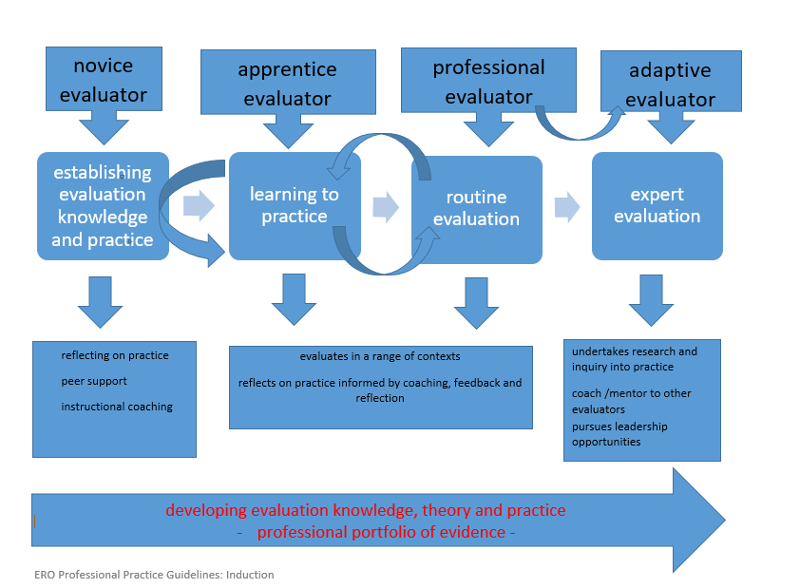

7. Evaluator training and development
Notes:
ERO is developing a profession of highly skilled evaluators, fully equipped for the challenges of the role in the 21st Century. At the beginning of this year ERO published a resource as a key component of our professional practice strategy. This resource sets out guidelines for a nationally consistent approach to the planning, content and provision of induction programmes for newly appointed review officers/evaluators.
The Induction programme is as an extended and ongoing process that consists of two broad and flexible phases where learning and performance is progressively developed and consolidated: the Novice evaluator phase and the Apprentice evaluator phase. The development of adaptive professional evaluators is seen as the outcome of this process.
The induction programme provides ongoing, flexible and planned support, tailored to the learning needs of each inductee. The programme has two distinct phases which will support the novice evaluator from an initial period of orientation to ERO and learning about evaluation, through an extended period of apprenticeship, to become a professional evaluator. The professional evaluator is a capable, skilled, self-managing practitioner who can plan, contribute to and lead evaluations in a range of contexts.
Following the formal induction programme, ongoing and targeted internal and external professional learning opportunities, coupled with personal professional inquiry, supports the professional evaluator to develop adaptive expertise and to become an adaptive professional evaluator. Adaptive professional evaluators demonstrate high levels of performance across the capabilities (which I will talk about next) and are well placed to provide evaluation leadership and coaching of professional practice.

Slide 30

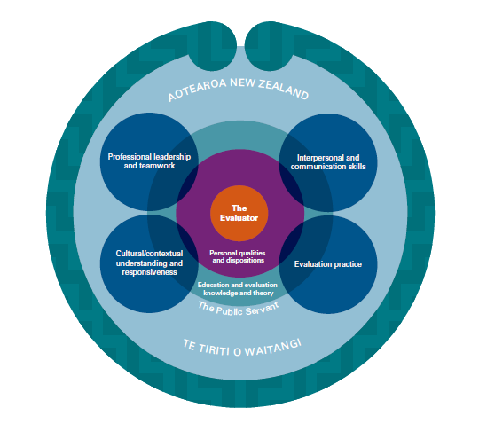
8. Evaluator capabilities
The capabilities are intended to:
guide professionalisation of our evaluation thinking and practice
guide provision of our evaluation training and professional development
assist individual evaluators to self-evaluate their own knowledge, skills and practice; make decisions about and monitor their own development
underpin quality assurance, both internally and externally
underpin the credibility and integrity of ERO’s evaluation work
support high standards and consistency of our professional evaluation practice across the organisation
be an explicit basis for Individual Development and Performance Management (IDPM) processes.
Notes:
ERO’s evaluation capabilities framework defines the capabilities that are needed to undertake and deliver high quality education evaluations. These are organised into three main frames: the role of the evaluator, professional practice and personal qualities and dispositions
The Appendix covers the theories and approaches, methods and techniques and skills expected of the evaluator.
The capabilities are similar to the Scottish approach in their Principles of Inspection and Review 2011.

Slide 31


9. Principles of professional practice
A focus on the learner and the equity and excellence of education outcomes.
Promoting external accountability and strengthening internal accountability.
A culturally and contextually responsive approach.
The integration of internal and external evaluation.
Technical rigour in evaluation design; data gathering; analysis, synthesis and reasoning; and the communication of evaluation information.
A participatory evaluation process.
The promotion of evaluation use.
Developing evaluation capacity.
Capable and ethical evaluation practice.
Notes:
These principles of practice have been developed from a review of the evaluation research and theory including a review of approaches in similar education jurisdictions. The principles are intended to guide the development of evaluation practice in the field as well as the design and implementation of ERO’s evaluation
frameworks and methodologies.
ERO also has a Code of Conduct for Review Officers. The Code of Conduct is based on the Standards of Integrity and Conduct issued by the State Services Commission under section 57 of the State Sector Act 1988.
In carrying out evaluations ERO evaluators are required to be fair, impartial, responsible and trustworthy. As is the case for every profession, ERO evaluators face ethical issues on a daily basis as they engage in practice. The way in which evaluators respond to these ethical challenges is an important influence on ERO’s integrity,
credibility and status as an evaluation agency.

Slide 32
The integration of internal and external evaluation (an example of one principle of practice)
This means that we will
use the education institution’s internal evaluation of how well it is achieving equity and excellence of outcomes for learners to focus our external evaluation discussions and activities
start by considering what the school knows from its internal evaluation about its own effectiveness in achieving equitable and excellent outcomes for learners and how well its organisational conditions support or inhibit improvement
discuss with participants their interpretation and evaluative thinking about their progress and achievement data and other information
evaluate the quality of internal evaluation processes and test the validity of internal evaluation findings and the effectiveness of internal evaluation processes
evaluate the effectiveness of internal evaluation processes and improvement actions in ensuring responsive education provision and equitable opportunity to learn for every young person and the school’s capacity for sustained improvement
use ERO’s evaluation resources to promote the integration of internal and external evaluation
enable schools to purposefully engage with external evaluation and use it as an opportunity to review, develop and validate its internal evaluation and identified improvement actions.
Notes:
For each of the principles of practice we have described what the principle looks like in practice. Here is one of the principles unpacked in terms of evaluator practice.

Slide 33
School evaluation has both internal and external components, and the two should be seen as working together.
New Zealand has ... gone furthest among countries internationally towards a collaborative school evaluation model, incorporating at the same time a sequential process ... [the] approach is collaborative in the sense that both parties attempt to work together to agree on a rounded picture of the school in which there is mutual recognition of its strengths and consensus on areas for development.
Nusche, D., Laveault, D., MacBeath, J., & Santiago, P. ( 2012). OECD Reviews of Evaluation and Assessment in Education: New Zealand 2011,
OECD Publishing (p.105).
Notes:
In conclusion I thought I would draw on the OECD report I referred to earlier in this presentation and share a quote from that report.
New Zealand has ... gone furthest among countries internationally towards a collaborative school evaluation model, incorporating at the same time a sequential process ... [the] approach is collaborative in the sense that both parties attempt to work together to agree on a rounded picture of the school in which there is mutual recognition of its strengths and consensus on areas for development.
We still have much work to do but have been on this pathway for many years, learning from the evidence and creating and sharing the evidence.
It is work in progress for us.

Slide 34
Internal vs External Evaluation
Everybody seems to hate external evaluation while nobody trusts internal evaluation.
David Nevo (1995)
Notes:
I love this quote from David Nevo. It is quite dated but makes me think about the future when we might be able to say
Nobody hates external evaluation and everybody trusts internal evaluation.
Or
Everybody loves external evaluation and trusts internal evaluation.
That is our challenge and maybe we are well on the way to realising it.

Slide 35
For more information
sandra.collins@ero.govt.nz
www.ero.govt.nz
https://twitter.com/EducationRevNZ
Notes:
Eskerrik asko berriro aurkezteko aukera
No reira
Tēnā koutou, tēnā koutou, tēnā koutou katoa

