Slide 1

The role of internal and external evaluation in an autonomous system. Estonian example
Kristin Hollo
Head of the External Evaluation Department of the Ministry of Education and Research

Slide 2
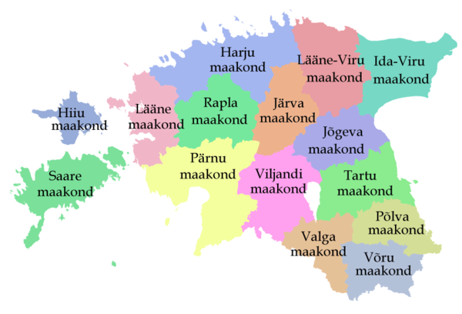
Background Information
1 315 944 citizens
15 counties
79 local governments (15 towns and 64 municipalities)
In many municipality less than 2000 people
More than 400 000 people living in Tallinn

Slide 3

Background Information
In 2017/2018 ca 147 894 students in the schools of general education
14 400 teachers working in schools of general education
There are 534 schools of general education in Estonia:
56 Elementary schools
295 Basic schools
164 Schools with upper secondary level
15 Adult education schools
Ownership forms of schools:
State schools 32
Municipal schools 442
Private schools 56
The Constitution states that maintenance of schools is a shared commitment between the state and local governments

Slide 4
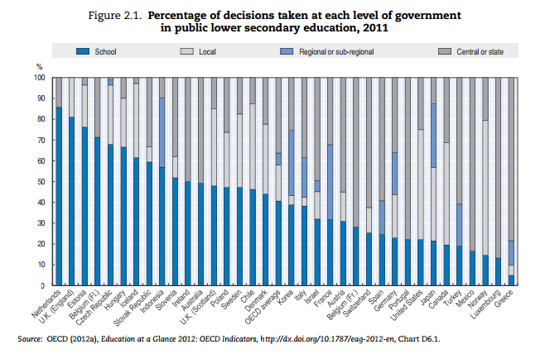
Autonomy and Responsibility
The governance of schooling is highly decentralised

Slide 5
School Evaluation System
School
Internal evaluation
Estonian Ministry of Education and Research
Policy, strategy, standards, inspection,
external evaluation of learning outcomes
Owner
(Ministry of Education and Research/Local Authority/a private company)
Supervisory control
County Government
inspection

Slide 6
Inspection
Ministry of Education and Research
Inspection in individual matters (problems, in case of complaints)
Thematic
Licences
the activities of an educational institution with a temporary education licence

Slide 7

Main Objective of the Inspection
The main objective is to ensure the accessibility of basic and secondary general education, also organisation of education and schooling, its quality and efficiency on equal bases.

Slide 8

Inspection
Inspection is exercised by the Ministry of Education and Research (since 2017).
8 inspectors+lowyer+ team leader + an analyst in the department of the External Evaluation
Besides the inspection they also solve complaints, exchange information between the ministry and the schools, conduct monitoring
No special training for evaluators. Instead of that:
Individual approach
Learning from experienced colleagues
Instruction manual
Meetings every week

Slide 9

We only inspect education activities.
We inspect lawfulness
Focus on school leadership (do not control the work of teachers)
2016/2017 school year:
76 thematic inspections
18 inspections in individual matters
20 inspections related to education licenc

Slide 10

The inspection and the management of financial resources of an educational institution are exercised by the owner
Administrative Supervision
Notes:
.

Slide 11

The Results of Inspection
The results of administrative supervision are set out in a statement.
The statements of inspections are public and the the results of administrative supervision are published on the website of the Ministry.
Summaries of the results of inspections are published every academic year at the state level.

Slide 12

Our challenges:
Fear
schools are not aware of the legislation - disappointment and anger towards inspection
the report is a difficult language
we will only highlight the shortcomings
What have we have done or decided to do:
friendly and supportive attitude in words and deeds
the opportunity to correct shortcomings before drafting a report, if it’s possible
Simplified summary of the report
highlight the positive findings the summary

Slide 13
Development Goals of the Inspection System
Greater impact through effective system
Risk-based evaluation – inspection must be reasoned and it requires existence of databases.
Greater involvement of the owner as a partner of the external evaluation: acknowledging the role and responsibility of the owner as a conductor of the supervisory control.
Increased attention to the owner and their obligations during the inspection.

Slide 14

OECD findings: „A considerable strength in the Estonian approach is the sustained focus on the importance of school self-evaluation. This supports the further development of professionalism and responsibility at the school level and, with effective procedures in place and an actively engaged school community, underpins a continual evaluation of the effectiveness of the organisation of schooling“
Internal Evaluation Matters!

Slide 15

Procedure of Internal Evaluation
The methods for carrying out internal
evaluation are chosen by the
educational institution.
Internal evaluation is an ongoing process aimed at ensuring the conditions supporting the development of students and the consistent development of a school. To that end the strengths and weaknesses of a school are identified and the development plan of the school is drawn up on the basis thereof. Following the goal, teaching and education and management is analysed and their effectiveness is evaluated in the course of internal evaluation.The procedure of internal evaluation is imposed by the headmaster.
The procedure for internal evaluation of a school is established by the head of school who submits it to the board of trustees for obtaining its opinion beforehand.

Slide 16

Counselling of Educational Institutions in Issues of Internal Evaluation
From 2006 to 2009 – obligatory
From 2009 to 2013 – optional
From 2013 – the ministry does not organize counselling

Slide 17
Internal evaluation < inspection
Internal evaluation
Development plan
Inspection

Slide 18
Internal evaluation is not implemented in all schools in such a way how we saw it and how we wanted
What is the problem?
School administrations and owners do not understand the importance of internal evaluation in ensuring the development of school
Lack of necessary skills
Insufficient data
How we intend to improve the situation:
Training of school administrations and owners
Manuals
More comprehensive information for schools and community

Slide 19
What have we done this year…
We have prepared various manuals
We have organized training days for local government officials
This year the theme of the thematic inspection is „Internal evaluation“
Interview the owner during the inspection and introduce the results of the inspection to the owner
Inform the owner about all complaints about the school

Slide 20
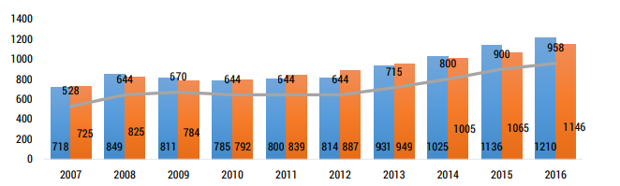
Information for internal and external evaluation
Official school performance indicators are set by the regulation of the Minister of Education and Research. The new set of indicators were introduced in 2016.

Slide 21
Why?
Accountability in the system with high autonomy
„School autonomy is related to student performance… particularly when autonomy is combined with accountability“ (OECD 2011).
1) Analysing own progress and learning from others for school leaders and keepers
2) Large variety of information for parents
3) ‘Thank you’ for data owners – richer data back

Slide 22
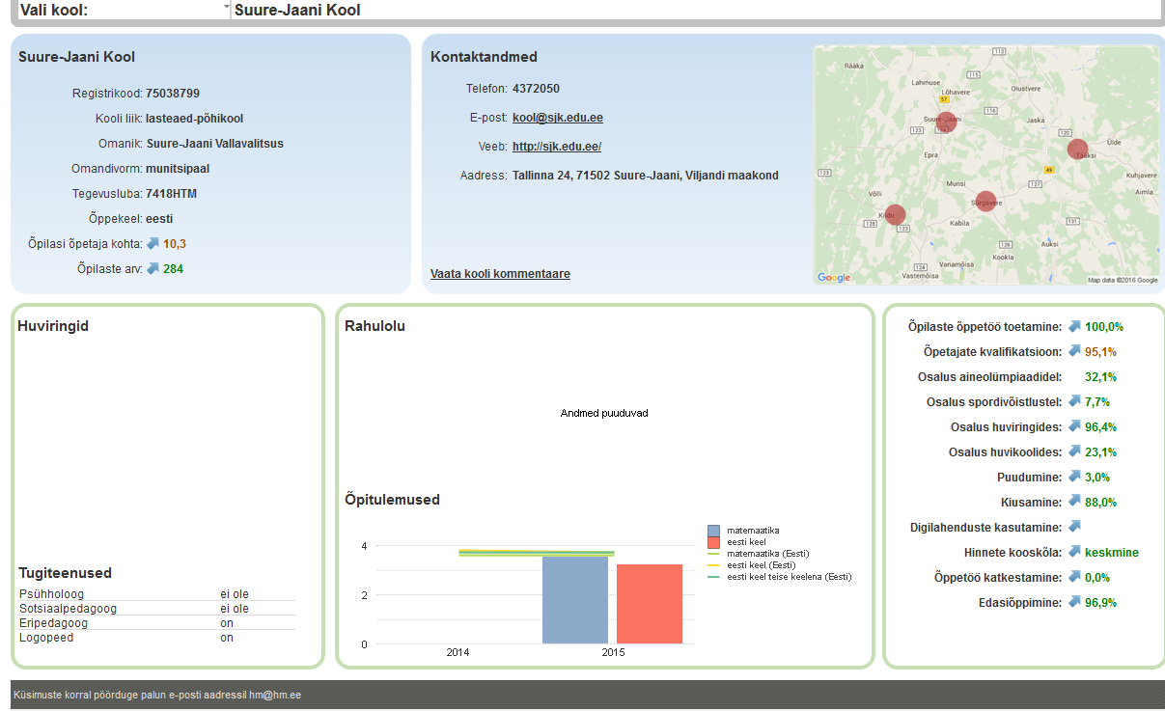
School card – work version
Notes:
22

Slide 23

Organization of external evaluation of the learning outcomes
National curriculum tests in 3rd grade: Estonian Language + Mathematics
Naional curriculum tests in 6th grade: Estonian Language, Mathematics, a secret subject
Exit examinations in basic schools: Estonian Language, Mathematics, an elective exam
State exams: Estonian Language, Mathematics, a foreign language

Slide 24

Areas in need of renewal till 2020
Redesigned measurement instruments and analytical options
National surveys to explain the factors affecting learning and teaching
Stakeholder feedback
Updates
Implementation of e-assessment
New fields of assessment
Notes:
24

Slide 25

THANK YOU FOR YOUR ATTENTION.

