Slide 1
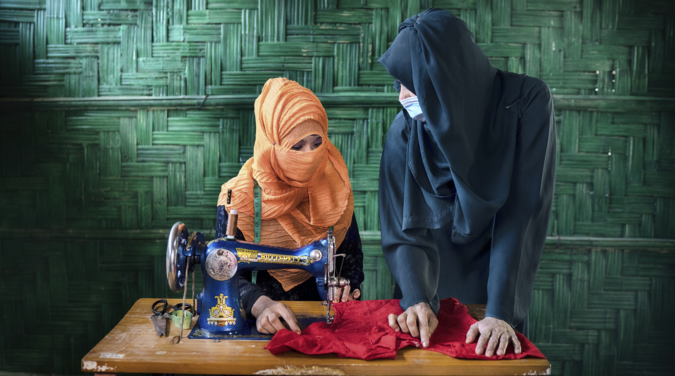

Oxfam impact investment programme
Investing in Women
@Fabeha Monir/Oxfam
Notes:
Yeasmin (left) is learning to make dresses in Bangladesh

Slide 2

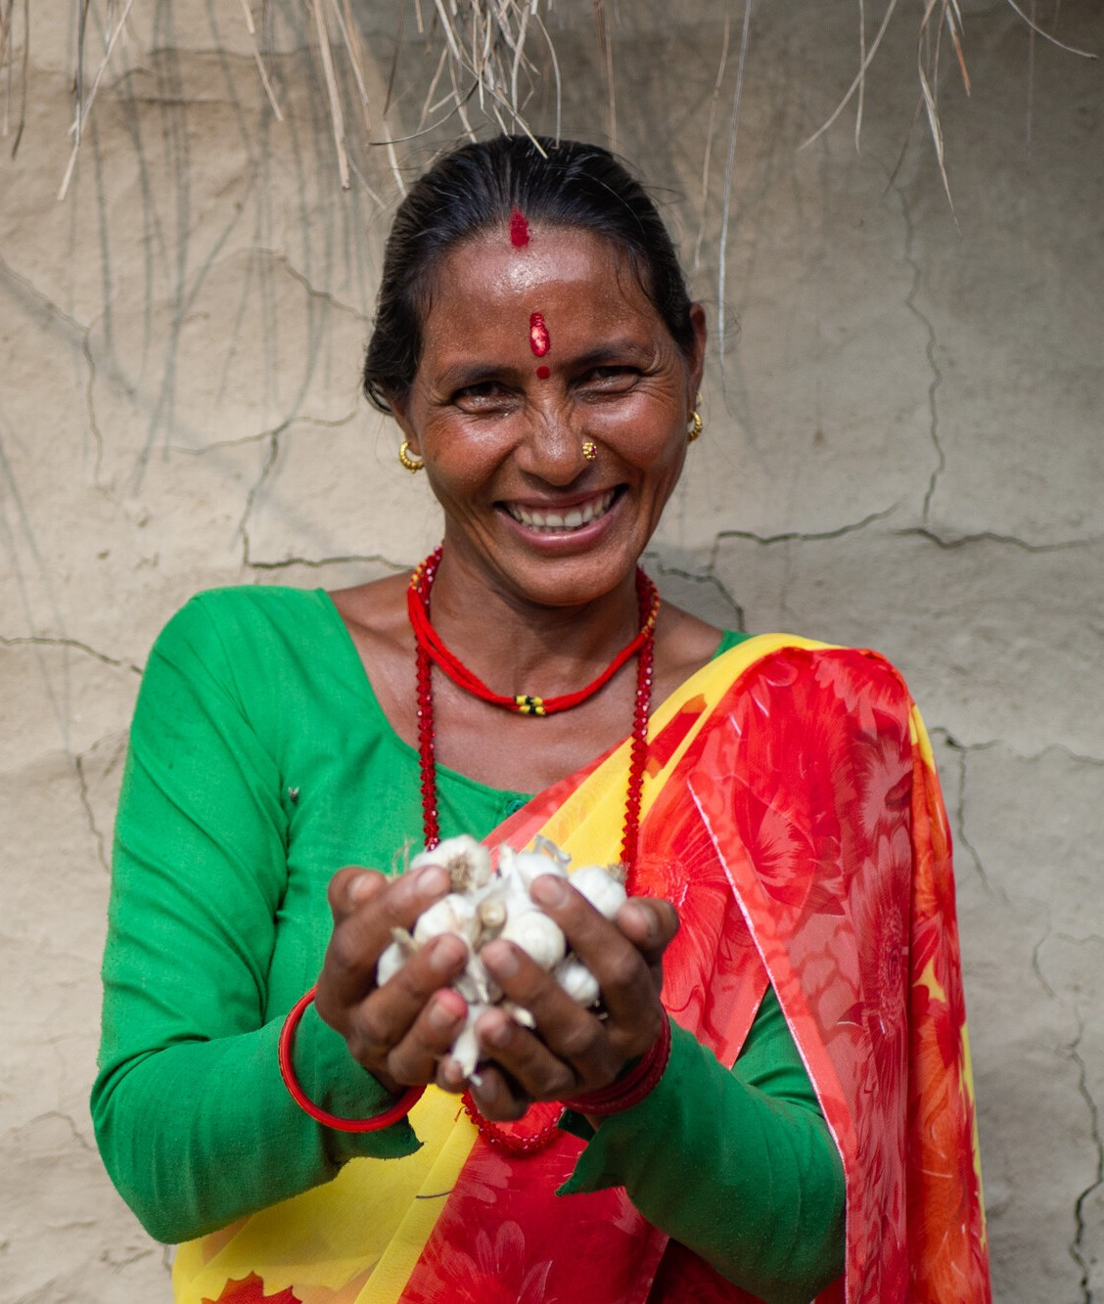
Background
Oxfam is moving its enterprise programmes from a venture philanthropy model towards an impact investing model.
We aim to:
Support the development of financially underserved small and medium enterprises with a particular focus on women’s economic justice.
Increase Oxfam’s social impact by accessing new philanthropic and impact investment capital which is aligned with our impact goals.
Bring Oxfam’s deep understanding of creating impact for women to the impact investing sector.
©Elizabeth Stevens/Oxfam
Bimala Devi Bhatta holds garlic grown by members of her community’s women’s group in Nepal

Slide 3
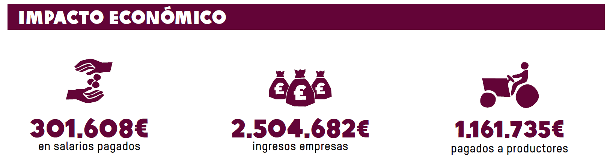
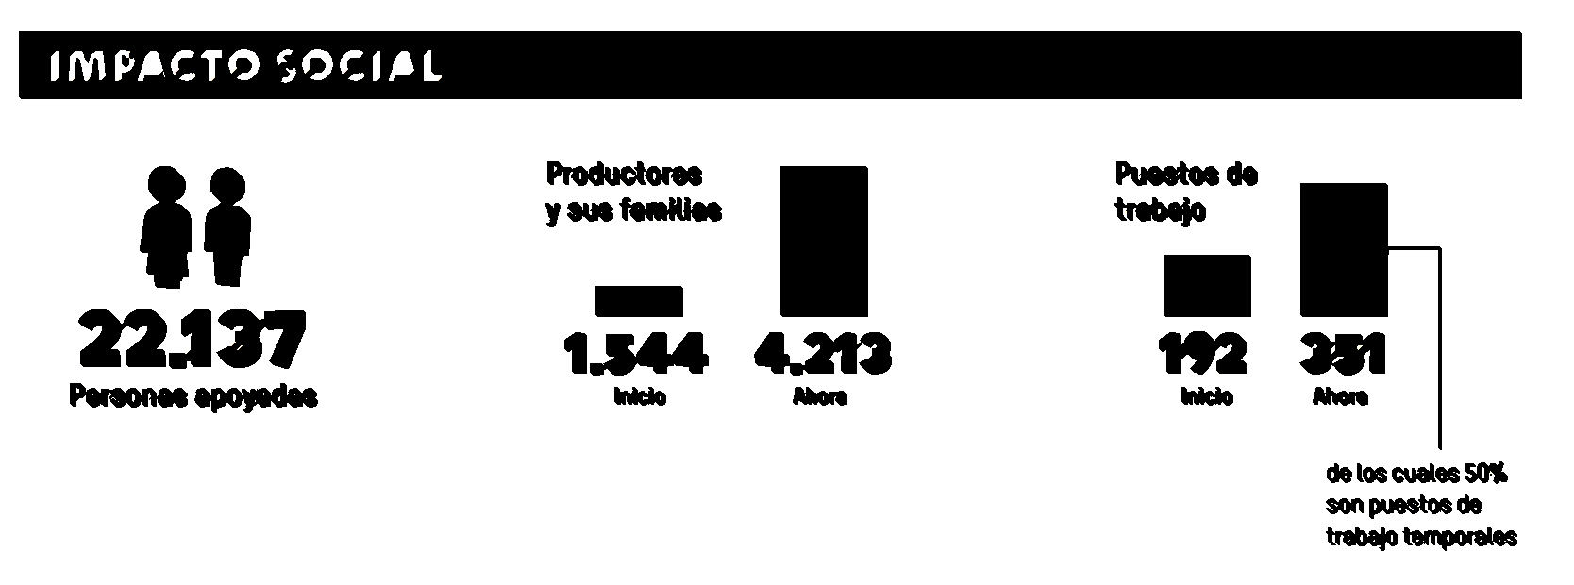
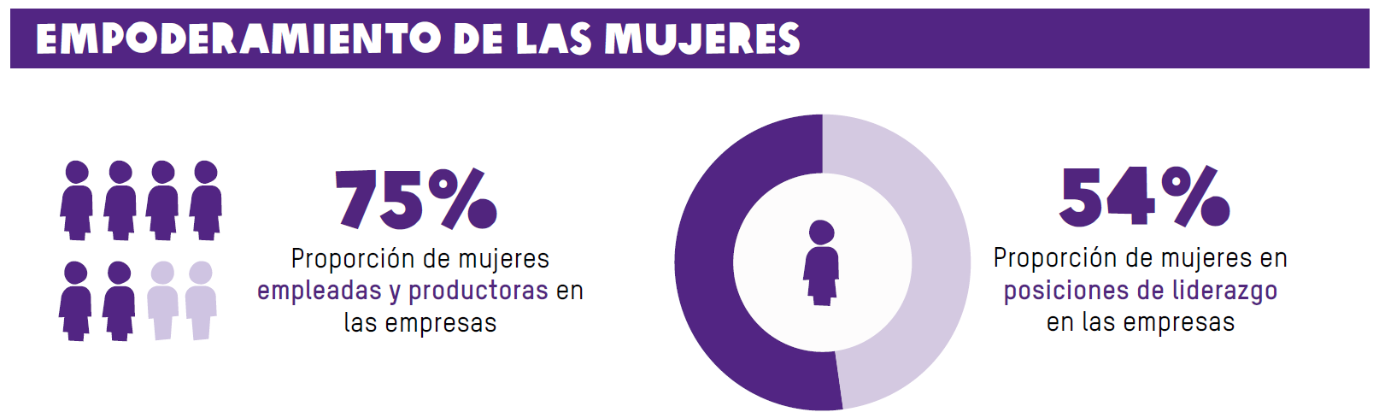

Oxfam’s track record in SME Investment
To-date supported 44 impact enterprises in 9 countries:
13-year experience of origination, investment and value creation in SMEs through Oxfam’s EDP & ECV programmes. Total budget: €11 million
Proven model of catalytic support for enterprises in developing markets. Every £1 invested the programme has generated over £3 in increased profits for enterprises, wages and income for producers.
Strong track record of guaranteeing loans with low historic default rates.
55K
Farmers reached
1500
JOBS Supported
49%
WOMEN PARTICIPATION
48%
WOMEN in LEADERSHIP
18,500
ADDITIONAL WOMEN IN WORKFORCE
21%
Increase in income for employees

Slide 4
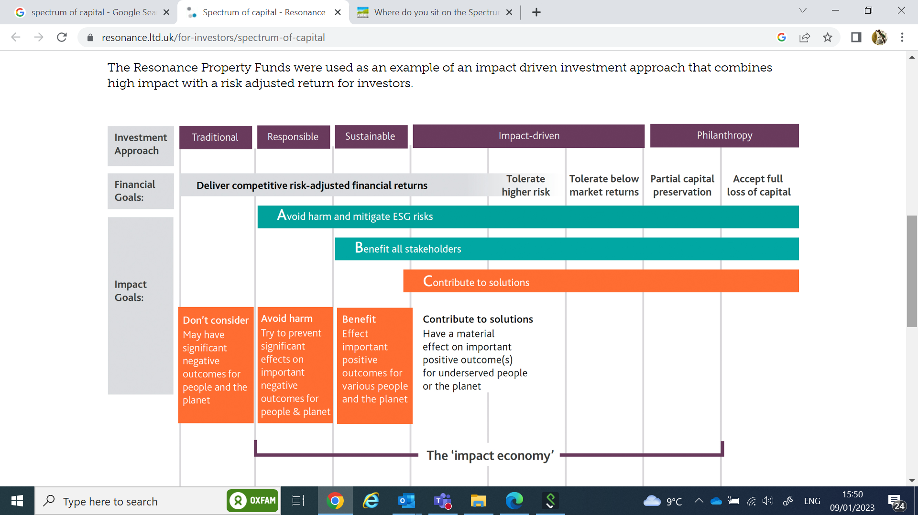
The Spectrum of Capital

Slide 5
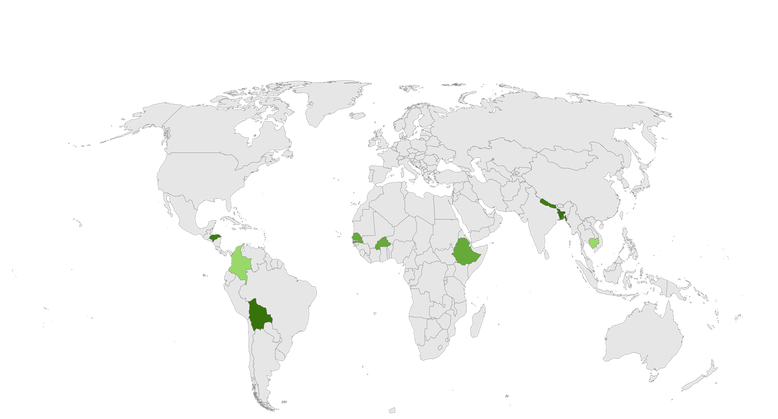
Overview of next phase
;
Global scope
High impact blended finance vehicle
$50 m over 10 years
Loans & technical assistance for impact enterprises from the missing-middle
Ticket size: $150-500K
Bolivia
Burkina Faso
Bangladesh
Focus on Women’s Economic Justice
Colombia
Senegal
Cambodia
Honduras
Ethiopia
Nepal
$7m pilot phase: $4m investment vehicle linked to a $3m grant facility
Support 35 enterprises in 2-3 years, across 4 countries

Slide 6
Opportunity
We are now seeking partners to co-create a brighter future for women entrepreneurs. We want value-aligned partners who are excited by the prospect of supporting a growing pipeline of businesses with a high impact on women. We are currently seeking:
GRANTS $3m
for Technical Assistance and Impact Management
FIRST LOSS GUARANTEE $0.5m
DEBT INVESTMENTS $3.5m

Slide 7

A high impact blended finance vehicle
Structure | Operations | Enterprises | Impact & return
$3m Grant
facility
Enables access for underserved enterprises
Delivering grants, Technical Assistance, and credit guarantees.
35 enterprises
Sectors including agriculture, e-commerce, handicrafts, technology & waste management
Improving incomes of 20,000+ women
Bringing 500+ women in leadership positions
Capital preservation for investors
$4m Investment
vehicle
Scale the programme:
Deploying investment capital in the form of strategic debt
Gestora de Fondos
2 year pilot in 4 countries

Slide 8
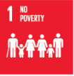



Target enterprises
We are sector agnostic, investing in enterprises led by women and enterprises that primarily support women delivering impact on women’s economic justice.
Women leadership
Decent work for women
Women in
value chains
Transformational products/services for women
Within the context of climate change:
Adaptation to climate change
Climate change Mitigation
Supporting the delivery of the Sustainable Development Goals:
@Fabeha Monir/Oxfam

Slide 9
Enterprise mix and support
Oxfam teams in each country source enterprises supporting bbusiness planning, conducting gender diagnostic, developing impact and gender strategy for each business and carrying out data collection incl. Sex disaggregated data prior to each enterprise entering the each stage.
3 stage approach
Support package
Objective
SCALE
$300K-500K loan
+ technical assistance
Term 4-5 years
Investment to scale
BUILD
$150K-300K loan
+ technical assistance
Term 4-5 years
Business and impact sustainability
MODEL
$30K-150k credit guarantee + technical assistance
Term 6-12 months
Investment
readiness

Slide 10

An innovative partnership
FUND MANAGEMENT
IMPACT MANAGEMENT
Gestora de Fondos
Role: Deploy of investment capital in the form of strategic debt, risk and portfolio management.
Role: Sourcing of enterprises, deployment of Technical Assistance, credit guarantees and impact management
Oxfam has a long acted as catalyst for new ways of reducing poverty. In 1991 we were a first-mover investor in Café Direct, a improving the lives of >1mn Fair Trade Coffee farmers. In 1998, we invested in the Micro Finance Fund which empowers MFIs in fragile contexts. In 2010 we were a first-mover in the START Network which catalysed ~$8mn in public funds.
Notes:
Oxfam s role:
Strategy:
Be the partner who leads with its in-country knowledge and expertise
Be responsible for driving the delivery of impact performance
Be expert in impact management, measurement and reporting
Be committed to leveraging its work to influence systemic change
Execution:
Partner with local enterprises and lead on the relationship
Co-ordinate packages of appropriate local technical assistance
Deploy grants, guarantee bank credit facilities, make outcome payments
Develop and promote an evidence base to drive changes in country policies
IM role:
Strategy:
Be the partner who leads decision making on financial risk management including country and sector diversification strategy, interest rate and FX risk management
Be responsible for driving the delivery of financial performance
Be expert in designing and maintaining the financial monitoring dashboard
Execution:
Lead financial due diligence for debt allocation
Structure deals
Ensure regulatory, legal and tax compliance
Lead on providing support to enterprises on areas including strategy, financial management, growth management, marketing and product development, and ESG
Bring in own expertise in new sectors as the programme expands

Slide 11
Pipeline
A solid pipeline already exists; grants and early-stage investments are already being made, to enable disbursement of loans upon launch of the investment vehicle.
Countries | # of enterprises | Debt volume
Bangladesh | 6 | $1,850K
Cambodia | 3 | $900k
Bolivia | 6 | $750k
Nepal | 2 | $300k
Burkina Faso | 2 | $200k
Senegal | 1 | $150k
TOTAL | 20 | $3,850k

Slide 12
Case Studies
Ethiopia Enterprise profile
Mela for Her is a social enterprise that aims to transform women and girls’ lives across Ethiopia. It provides access to affordable and eco-friendly menstrual products and menstrual health education.
Investment
$40,000 loan to expand production facilities, $35,000 in technical assistance to improve marketing, facilitate international mentorship for
business managers & training women sales agents.
Impact
Over the next three years they will hire 130 young women in production and sales, 30 production, 100 sales and increase production from 10,000 pads/month to 50,000 pads/month. This will enable them to reach 100,000 women.
Bolivia Enterprise profile
APROMAM produces and exports organic peanuts from more than 190 small local farmers, offering them better prices, resources and technical assistance.
Investment
$120,000 credit guarantee to finance working capital and equipment + $50,000 technical assistance to strengthen the company, increase number of organic contract farmers and increase farmer income.
Impact
  Revenues $210,000
  Workforce 20 jobs created and sustained
  Women 142 women directly benefiting through the supply chain

