Slide 1
Fostering applied research and innovation through industry partnerships in Australia
International Congress on Vocational Education: Relevance of vocational education to competivitity and employment
28 – 30 May 2014
Donostia-San Sebastian
Mary Faraone, CEO, Holmesglen Institute, Australia

Slide 2







Holmesglen at a glance
51,000+ course enrolments
13m+ student contact hours
43,700 domestic student enrolments
$162m total operating income
8,000 overseas student enrolments
(inbound and offshore)
1400 staff
18,300 effective full time load
4% higher education
28% diploma and ad. diploma
57% vocational certificates
7% apprenticeships
3% senior secondary
1% non-award
$429m total assets
Source: internal unpublished data, 2013

Slide 3

Key Features of the Australian TVET system – mixed bag
The good, the bad and the ugly
Change, change and more change

Slide 4
Key Features of the Australian TVET system – mixed bag
Internationally well respected and recognised
National Training Packages – key feature
Industry Skills Councils – develop National Training Packages
Federated model however 8 separate jurisdictions with 8 different funding models
Move from fully funded by government in 2008 to various competitive funding models across the 8 jurisdictions in 2014
National regulator – Australian Quality Skills Authority however various additional versions in the jurisdictions to manage funding contracts
No clear vision for public TVET provision or providers
Poor perception of TVET compared to higher education
Decrease in paraprofessional qualifications due to competition of demand driven funding in higher education
Ad hoc involvement in research and development
TVET system is almost entirely excluded from Australian government innovation policy

Slide 5
A snapshot of the Australian TVET system (2012)
2,110 training organisations delivered publicly funded vocational education and training (VET)
  61 TAFE institutes (publically owned providers)
  312 community providers
  1,817 private providers
1.9 million students enrolled in the public VET system, of which:
  64.7% at TAFE and other government providers
  20.4% apprentices and trainees
  83.3% studying part-time
  6.4% with a disability
  15.8% from a non-English speaking background
  51.5% male
  25.6% 19 years or younger, 17.1% 20-24 years, 36.7% 25-44, 20.2% 45 and over
12.5% of people aged 15 to 64 years participated in publicly funded VET
  33.4% of Australians aged between 15 and 19 years participated in VET
Source: NCVER, 2013, Student and Courses 2012, NCVER, Adelaide.

Slide 6
Innovation is…..
……is the implementation of a new of significantly improved product [good or service], process, new marketing method or a new organisational method in business practices, workplace organisation or external relations.
OECD 2005, Oslo Manual, 3rd Edn., OECD and European Commission, Paris.
Pure research is useless; innovation is gold
Moodie, G 2006, Vocational education institutions' role in national innovation, Research in Post-compulsory Education, 11 (2), 131-140.
Innovation, especially process and incremental innovation, depends on a skilled workforce……it is enterprises, not governments, which are at the heart of the innovation process. Enterprises take new ideas, turn them into a product or service and then market the result. In turn, they need the right people with the right skills and knowledge to help them do this. People are the innovators.
Guthrie, H & Dawe, S 2004, Overview, in S Dawe (Ed.), Vocational Education and Training and Innovation: Research Readings, NCVER, 10-19.

Slide 7

Innovation and the TVET system
“..despite the weight of academic evidence from the innovation studies discipline the VET system is almost entirely excluded from Australian government innovation policy”
Toner, P & Dalitz, R, 2012, Vocational Education and training: the ‘terra incognita’ of Australian innovation policy, Prometheus: Critical Studies in Innovation, 30(4), 411-426.

Slide 8
Key innovations in Australian TVET system
2009:
Training Packages – industry informed
Australian Technical Colleges
Flexible Learning Advisory Group
OECD/CERI, 2009, Systemic Innovation in the Australian VET System: Country Case Study Report, OECD.

Slide 9
Five years is a long time in TVET…..
Training Packages
Australian Technical Colleges 
Flexible Learning Advisory Group 
Innovation is systemic but innovative products, processes are a snapshot in time

Slide 10
OECD/CERI Study conclusions…..
Drivers of change
Facilitators of innovation
Barriers to innovation
Weak Evaluation Culture
“ There is a growing body of knowledge which has demonstrated that innovation happens at different levels and that employee (skilled worker) and user-driven innovation have an essential role to play in innovation processes. These reflections – especially pertinent for SMEs, could guide policies to redirect and vitalize systemic innovation in VET.” OECD/CERI, 2009, Systemic Innovation in the Australian VET System: Country Case Study Report, OECD.

Slide 11
Applied research
Basic research is experimental or theoretical work undertaken primarily to acquire new knowledge of the underlying foundation of phenomena and observable facts, without any participation application or use in mind.
Applied research is also original investigation in order to acquire new knowledge. It is, however, directed primarily towards specific practical aim or objective.
OECD, 2002, Frascati Manual, 6th Edn., OECD Publishing

Slide 12
Fostering applied research
Scholarly practice
Boyer Model
Scholarship policy and guidelines:
  Organisational and social resources, including funding, time, opportunities for dialogue
  Work practices that produce, share and validate scholarly outputs
  Workplaces, developing a culture of scholarly practice and organisational responsiveness
  Organisational and individual capacities
‘applied research and development is not something for which the VET system has a reputation, bit it’s occurring in many colleges. This is a specific but unharnessed VET capability which could be developed more fully to assist in the innovation capacity of the nation’
Whittingham, K 2003, Going Boldly into the Future: Skills and Australian High Technology Start-up Enterprises, NCVER.

Slide 13
Scholarship – Boyer’s model
Boyer advanced a redefinition of concept of scholarship as four separate yet overlapping functions.
Type of scholarship | Purpose | Measures of Performance
Discovery | Build knowledge through traditional research | Publish in peer-reviewed forums. Producing and/or performing creative work within established field. Creating infrastructure for future studies.
Integration | Interpret and bring new knowledge to original research and make connections across disciplines | Preparing a comprehensive literature review. Writing a textbook for use in multiple disciplines. Collaborating with colleagues to design and deliver a core course.
Application | Apply knowledge to create new understandings and aid society and professions to address problems | Serving industry or government as an external consultant. Assuming leadership roles in professional organisations. Advising student leaders, thereby fostering their professional growth.
Teaching | Study teaching models and practices to achieve optimal learning | Advancing learning theory through classroom research Developing and testing instructional materials. Mentoring graduate students. Designing and implementing a program level assessment system.

Slide 14
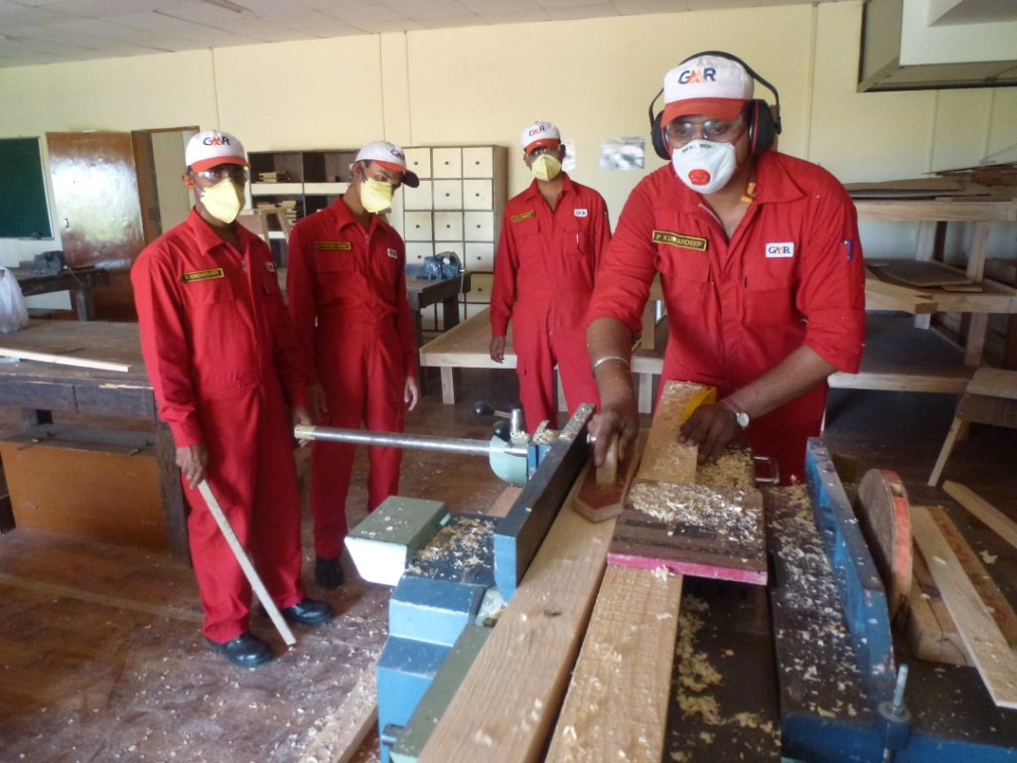

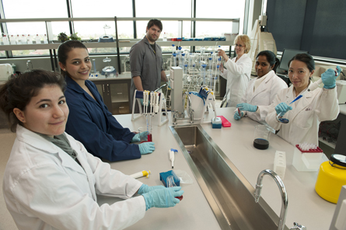
TVET and industry
Background
Linkages
Case studies

Slide 15

TVET, industry, applied research and innovation
How does it all come together?

Slide 16

Case study: Victorian simulation alliance
Founded in 2010 this ‘community of practice’ has developed into an innovation collaboration that fosters applied research to support the industry. Key activities:
Facilitating ongoing professional development and education
Scenario development and sharing
Information dissemination
Linking metropolitan, rural and regional areas
Creating a cohesive voice and common language
Best-practice identification and sharing
Fostering inter-professional practice, collaboration and
partnerships
Facilitating inter-organisational research and projects
Informing standard and policy setting
Identifying opportunities and lobbying for funding
Linking nationally and internationally.
....“Create an environment that fosters collegiality, collaboration, networking and sharing among those engaged in health professional simulation-based education and research.”

Slide 17

Case study: Healthscope/Holmesglen partnership
Establishment of private hospital on the Holmesglen Campus in conjunction with an Education Agreement and a joint Clinical Chair

Slide 18
Conclusions/Recommendations
Much activity is :
Local
Ad hoc
Disconnected to policy and funding
Not systemic

Slide 19
Conclusions/Recommendations
Gavin Moodie recommends a role for vocational education institutions in stimulating innovation if they take the following six steps:
Emphasis innovation; eschew research
Develop a distinctive role in the national innovation system
Act locally, learn globally
Form multiple partnerships
Establish a national network of vocational education innovation institutes
Act in the long term
Moodie, G 2006, Vocational education institutions' role in national innovation, Research in Post-compulsory Education, 11 (2), 131-140.

Slide 20
Conclusions/Recommendations
To enhance the links between the VET sector and business innovation in Australia, Richard Curtain makes two suggestions:
Access to government research and developmental funding, focusing on processes and development rather than pure research, would bring the VET sector closer to business innovation.
Government research and development funding to the VET sector could be solely focused on small and medium sized enterprises.
Curtain, R 2004, Innovation and vocational education and training: lessons from leading innovation systems, in Dawe, S (Ed.), Vocational education and training and innovation: Research readings, NCVER, 42-58.

