Slide 1
Public policies for a productive and entrepreneurial economy- the role of VET
Hanne Shapiro
Danish Technological Institute
VET Conference
St. Sebastian, Basque Country
Notes:
Thanks to Basque overnment- thanks to Jose louis Fernandez from Tknika- for being here-
What we furter learned about Tknika- and the way the Basque government frames Vet makes me proud and honored to be here- BIT about where I come from
DTI what are we- more than one years old- role in the innovation system- SME- enablign policy ramework for Smes- my center policy analysis- have my roots in the Vet system started out there- been also in the Danish Ministry fo Education and in One of teh European agencies
On technology difusion and education

Slide 2
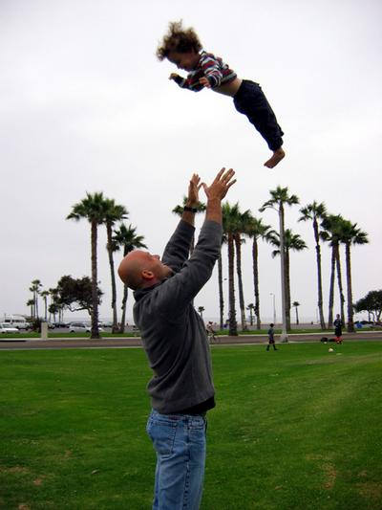
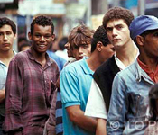


Envisioning-
Aligning
Engaging
Notes:
Hopefully we are now towards the end of a major crisis- which has left us with the risk of ” a talked about as the ”lost generation”.
Growing inequality globally– not evident that it will be a job rich recovery- good quality jobs- growing number of people- vet reciew
Self-e ployed- not out of choice- but necessity- in this context- VET systems do have a major role to play-
Not least high quality work placed VET systems- specifically nto just saying apprenticeships- level of regulation can make it a challenge in some countries- in some sectors- Also an exciting time- just started a major new contract- methodology for participatory review of app systems- for CEDEFOP-european agency for VET--

Slide 3
Background- analysis
SME’s in global value chains- role of digital technologies
State of Affairs- Manufacturing industry EU- European Parliament
SME growth strategies- international best practice- design of Danish SME Growth Programme
PIAAC data- Adult Learning indicator- DG EAC
VET Excellence- VET and innovation- DG EAC
World Economic Forum- Work on Employment rich recovery- role of apprenticeship

Slide 4
7 Emerging issues
Biggest SME challenge in EU 28- lack of customer demand
Major changes in markets/ inclusive innovation as growth opportunity- OECD World Bank, World Economic Forum?
Limitations of skills supply policies –

Slide 5
7 Major Isssue emerging Cont
The role of VET in economic development and innovation?
Unrecognised role of the skilled worker in innovation in SMEs- DUI Innovation-
But not all SMEs are set to exploit that opportunity
VET excellence?

Slide 6
Opportunity space for SMEs
Multinationals concentrate number of SME suppliers – become partners in innovation
Digital technologies become a proxy for efficiency – and a means of cooperating across firm boundaries /( shared standards )
Growing integration of products , components, systems and services- modularisation a means to meet diversified demand cost- effectively
Critical factor : capabilities at the shop floor level DUI Innovation – modularised products/services
Notes:
Fewer Subsuppliers- more strategic roles as development partners, but also more requirements to the same companies- characteristics of the succesful ones

Slide 7
BIG policy question- implications on VET??????
Digital taylorism to improve efficiency/ productivity in European SMEs
or
The shop floor not a cost but a source of innovation (the role of the shop floor/ front line worker)

Slide 8
Skills Utilisation
Efficient skills policies must address skills utilisation
Implication on VET systems: From training providers – to ??
Numerous programmes aimed at enhancing the skills of the future existing workforce
Few programmes at scale that situate work organization , job redesign, technology utilisation and skills as a means of improving competitiveness

Slide 9
Innovation : to orchestrate teaching and learning processes-
R&D driven innovation: investments, capacity, risks, costs- problems taking products to the innovation stage
User and employee driven innovation as interactive and learning based models: doing, using, interacting
Work organisation and leadership practices
Employees tacit experiences
Markets, customers,
suppliers, other providers
in the knowledge system?
Value added: products , services concepts

Slide 10
The enabling role of ICT- BUT?
In DK fx 1 mill Danes 16- 65 years who cannot solve basic problems in an ICT environment-
Higher order numeracy- literacy: analysis, synthesis, envisoning/ simulation , understanding complex data problem shooting, problem identification
Emulating work environment+

Slide 11
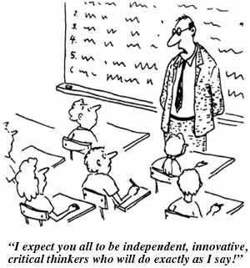
New Skills New Jobs?

Slide 12
Role of VET institutions
Skills utilisation could be part of the
wider business support structure a VET institution offer
Horisontal and vertical cooperation within the innovation system- enabling policies?
Build capacity for better skills utilisation as part of a firm’s strategic planning (clusters, networks, value chain upgrading.)

Slide 13
Work placed learning/ apprenticeships
Competence/ Learning outcomes- learning at school – learning at work as an integrated setting; ( dedicated school staff)
Learning- (knowledge, skills, and competences) - routinisation/ progression in complexity-
“the company’s hidden repository”
A learning environment that offers opportunities to reflect on practice/transcend practice- different communities of practices
Status and an employee- but also as a learner
Measures focusing on building employers’ capacity to host learners/ measures to adapt to the needs of the company;
Process and tools to support - reflective practice

Slide 14

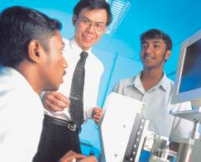
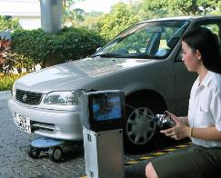
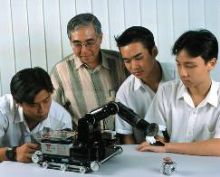
PROCESS-ORIENTED PEDAGOGIC MODEL
LEARNER/ USER
Scoping
Technical,
Methodological
& Social
Competencies
Experimenting
Performing - or?
Envisioning/
CreatingE
14

Slide 15
Work Placed Learning- Design for real use
Real-world relevance: Authentic activities match the real-world tasks of professionals in practice. mimicking “the professional practice.”
Ill-defined problems: ( wicket problems) Authentic activities are relatively undefined and open to multiple interpretations, requiring students to pose questions, experiment, and see a problem from different perspectives.
Design thinking ( role of simulations)
OER- the Wider community network- Open

Slide 16
21 st Century VET –
Global value chain perspective
Envisionment prioritisation what are the genuine local assets?
Great global challenges-
rethinking manufacturing for solutions that matter
Rethinking local assets
Enabling factors
Policy Aligning- economic, labour market, ed
Institutional autonomy- multi-dimensional accountability
Strategic linkages and partnerships the local community-
Recognition of prior learning
”Tinkering” for the real world- ( entepreneurial skills– technological skills, problem solving, design to cost, collaboration, entrepreneurial capcity- Innovation)
The factory as a learning model – experimentation. Trial and error. Production Methaphor for learning
OER- Source materials:
producing artefacts for a real world- simulations
Social Enterprise- rethinking public works
Consider scale and mainstreaming from the outset

Slide 17
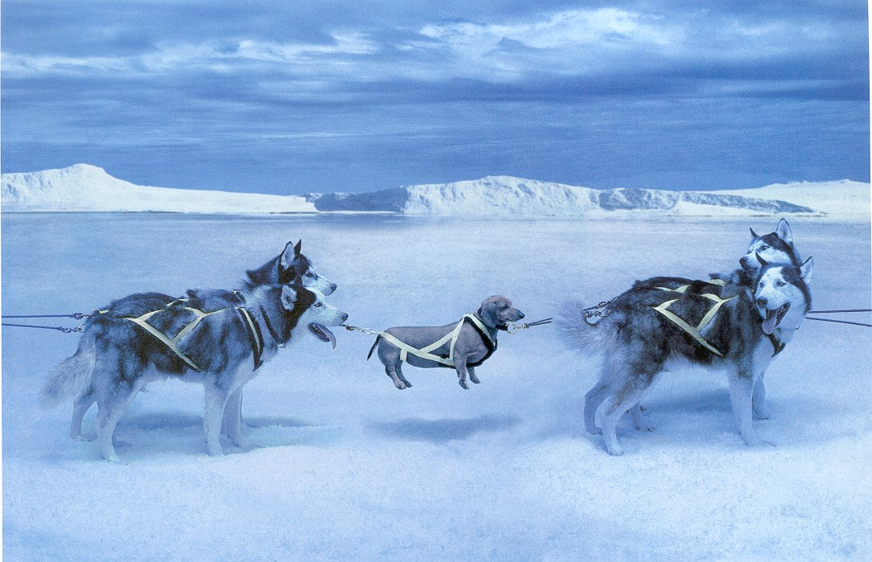
Getting it right for everyone!
Thanks
Hanne Shapiro-
Danish Technological Institute- hsh@teknologisk .dk

