Slide 1

Inspection and school self-evaluation for change;
Do inspection and evaluation lead to improvement?
Dr. Melanie Ehren
www.ioe.ac.uk/lcll
Notes:
1
Bilbao, 7 June 2018
Title: INTERNATIONAL MEETING ON SCHOOLS’ INTERNAL AND EXTERNAL EVALUATION
Subtitle: The role of Education Inspection

Slide 2
Purpose of this session:
‘Do inspection and evaluation lead to improvement?’
Conceptualizing ‘accountability’ and ‘school self-evaluation’
Various types of accountability systems
Research evidence on the role of inspection and evaluation in promoting improvement and ensuring accountability;
Exploring the relationship between external evaluation and institutional self-evaluation and how both can drive improvement in different ways
Notes:
2

Slide 3
Evaluation
Accountability
Monitoring
Inspection
Assessment
….
Notes:
3

Slide 4
So… what do we mean by ‘educational accountability’?
Different conceptualizations:
Klijn and Koppenjan (2014, p.264)
‘the extent to which actors (accounters: those rendering accounts) are held accountable for their behaviour and performance by other actors (accountees: those to whom account is rendered)’.
Schillemans (2013, wp) 3 phases of accountability:
Information phase
Debating phase
3) Judgment phase (and sanctions/rewards)
Answerability, Responsibility, Enforcement (Bovens, 2008)
Notes:
1) Information phase: the agent/accountor/actor renders an account on his conduct and performance to a significant other.
2) Debating phase: the principal/accountee/forum assesses the – orally or in writing – transmitted information and both parties often engage in a debate on this account. The principal/accountee/forum may ask for additional information and pass judgment on the behaviour of the agent/accountor/actor. The agent/accountor/actor will then answer to questions and if necessary justify and defend his course of action.
3) Sanctions or judgment phase: the principal/accountee/forum comes to a concluding judgment and decides whether and how to make use of available sanctions.

Slide 5
  What do we mean by ‘educational accountability’?
  Three conceptualizations of accountability:
  looking at accountability systems (or ‘mechanisms’) as a specific type of (high stake) intervention,
  how these systems make people/organizations more accountable or answerable (accountability as an outcome in itself), and
  viewing accountability from a perspective of relationships between actors (an organisation/person holding someone else to account).
Notes:
5
Answerability: obligation of the government, its agencies and public officials to provide information about their decisions and actions and to justify them to the public and those institutions of accountability tasked with providing oversight.
Enforcement: public or institution responsible for accountability can sanction the offending party or remedy the contravening behavior.

Slide 6
Accountability versus learning/improvement as an outcome of inspection
Accountability: checking up on legislation, sanctions for ‘trespassing’
Improvement: evaluating quality of schools, feedback/support/advise (in liaison with other stakeholders)

Slide 7
  Types of Educational Accountability
  According to goal, locus, focus:
  Goal: control, support/improvement, liaison
  Focus: input, processes, output, outcomes
  Locus: who holds whom to account
  Potential role conflicts when combining different goals?
  What do you think?
Notes:
7

Slide 8
  Potential role conflicts?
  Tension between control and support
  Tension between standardized procedures and need for tailor-made services
Notes:
8
GOALS
Control/checking compliance
The control function relates to the original meaning of the word ‘inspection’ and is at the heart of compliance monitoring. In many countries, control is considered to be the essential function of school inspectors as is shown in the following examples.
In Spain, the first function of the Inspectorate Service is to “ensure that the laws, regulations and any other legal dispositions of the educational administration are fulfilled in schools and services”. Similarly in the Netherlands, “the primary responsibility of the inspectorate has always been to ensure compliance with statutory regulations. This has traditionally been seen as an important way of ensuring that the teaching and training provided within any given sector is in principle the same. De Grauwe (2007: module 2, p.8)
Compliance checks are often concerned with the efficiency of provision, in terms of compliance with the statutory guidance in operation at that time, based on good practice. School inspectors for example observe and enquire into whether a provider is complying with the standards, commonly set out in a checklist. These standards focus for example on the qualifications of teaching staff and other evidence of the competence of teachers and the physical conditions in which children are educated. The outcome of such a compliance check, whether part of an inspection or a school internal evaluation is to highlight any breach in compliance to regulation and to sure these are amended.
Support, evaluating/professional judgement of school quality
Support often takes the form of advice to teachers and headteachers during inspection visits, but some countries also put into place other arrangements such as individual tutoring, demonstration of lessons, in-service training programmes and organisation of peer learning. Support is closely linked to control and ties in to the goal of improvement.
Evaluation and inspection frameworks that aim to support improvement will however go beyond checking compliance to regulation (as is the core task of control-oriented evaluations and inspections) but will also seek to evaluate and assess school processes. It may be helpful at this stage to think of evaluation and particularly inspection activity on a soft-hard continuum from evaluation to compliance. At one extreme, purely evaluative inspection leads to qualitative judgements about shades of effectiveness. At the other, regulatory inspection leads to binary judgements: meets or fails to meet the specified requirement (see Figure 3.1).
Liaison
Control and evaluation of school quality often inform a third function of school inspections: acting as a liaison agent between the top of the education system (where norms and rules are set) and the schools (where education is shaped and takes place). Inspectors act as go-between agents in having a task to inform schools of decisions taken by the centre, and to inform the centre of the realities at school level. In decentralized systems, where school boards govern a large number of schools, internal evaluators can also have a liaison function in connecting the school governing body to the individual schools they govern.
This liaison role is increasingly expanding to include horizontal relations in identifying and spreading new ideas and good practices between schools, particularly when ambitious reform programmes are being launched. Consequently, the role of school inspectors in disseminating reforms and in ensuring smooth implementation at the school level becomes increasingly important. Finally, liaison can also include establishing good linkages with other services involved in quality development such as pre- and in-service teacher training, curriculum development, preparation of national tests and examination. These roles can focus either on the individual teacher, on the school as a whole, or on the (monitoring of the) entire education system.
Specific examples of different goals and functions of particularly Inspectorates of Education have been provided by Ehren et al (2013) who summarize the main aims of Inspectorates of Education in six European countries, which often refer to good education in individual schools and/or the education system as a whole.
FOCUS:
school inputs, and norms and regulations. This type of monitoring is referred to as ‘compliance monitoring’.
Instructional processes, and what goes on in the classroom. This type of monitoring is referred to as ‘diagnostic monitoring’.
School results (e.g. student achievement). This type of monitoring is referred to as ‘performance monitoring’.
LOCUS:
De Grauwe (2007, M1) also talks about how the locus of monitoring systems may vary in locus:
the education administration, represented by the Ministry (public/state control model).
the teachers themselves (in a peer review model; also referred to as the professional accountability model).
parents in close relationship with the school (the partnership model), or
the general public by means of parental choice and competition between schools (the free market model).

Slide 9
  Now let’s look at school self-evaluation…
  When is an evaluation a ‘school self-evaluation’ and when is it an external evaluation?
Notes:
9

Slide 10
School self-evaluation (Kyriakides and Campbell, 2004; Devos, 1998):
A process mainly initiated by the school to collect systematic information about the school functioning, to analyse and judge this information regarding the quality of the school’s education and to make decisions that provide recommendations.
Systematic information?
Analyse and judge (who, about what)?
Decisions and recommendations: about what, to whom?
What is the underlying purpose? (political context, accountability, PD)
Does this lead to improvement?
Notes:
10

Slide 11
Value assumptions underlying school self-evaluation: how are these different for assumptions underlying external accountability?
Commitment to:
treating human beings as natural learners
continuous change
developing ownership
gathering evidence
Continuous reflection in action and commitment to learning from all members in the organisation, ownership over process of development and change
Notes:
11

Slide 12
Some reflections:
External accountability takes away ownership over change? One shot activity of evaluation? High stakes environment creates a risk averse culture where SSE becomes a ritual?
But: has also promoted change and ensured schools engage with SSE as a way to be inspection-ready. Critical (external) friend, providing benchmark information and increasing expectations. Providing a valid framework for evaluation and accurate, high quality –empirical- data to underpin evaluations (instead of only opinions on surveys, based on n=1), galvanizing external support
Notion of internal versus external motivation for change. Do some schools need such external motivation when there is little internal capacity for improvement?
Notes:
12

Slide 13
Effective SSE requires:
Climate of trust, openness and collaboration (leadership)
Procedures for collection and use of data
Criteria for measuring school effectiveness (conceptualized differently for teaching, school organization)
Notes:
13

Slide 14
Defining inspections:
External evaluations of schools
Undertaken by officials outside the school with a mandate from a national/local authority
Regular visits to schools to collect information about the
quality of the school, check compliance to legislation and/or evaluate the quality of students’ work (e.g. through observations, interviews and document analysis) (De Grauwe, 2007)
Not to be confused with supervision (which involves line management); sometimes also called ‘quality review’

Slide 15
Inspection systems vary:
Goals: accountability/improvement/capacity-building
Standards and targets: process/output/outcomes
Measurement methods: tests, desk research, school inspections, results of internal evaluations
Stakes: sanctions, rewards, interventions
Reporting: public reports of schools; annual reports

Slide 16
      Advance organizer:
      Which effects and side effects of inspections do you see/expect?

Slide 17
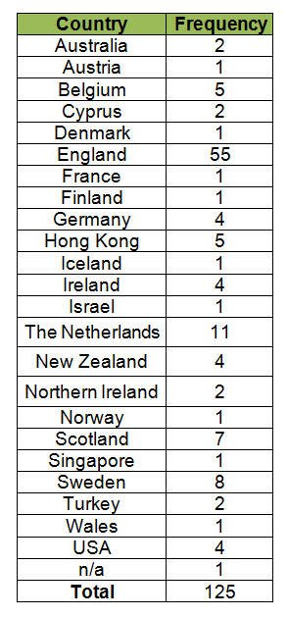
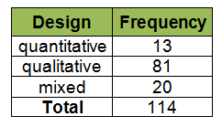
Literature review
Notes:
17

Slide 18

What are effective inspections?
Reflections on school/teaching quality
Intentions of (head) teachers to change
Behavioural change of teachers and school leaders (in general and of failing schools)
Improvement in self evaluations, capacity and professional development
Improved student achievement

Slide 19
Reflection on quality:
Chapman (2002, England):
Most (teachers) reported that they already knew their priorities for improvement and did not need Ofsted to tell them. However, some did admit that these issues became re-emphasised and some may have worked more strongly towards them having been ‘endorsed’ by the inspection team.
The inspection process was seen to encourage reflection on practices, particularly ones that led to better achievement
Pennincks, Vanhoof, De Maeyer, Van Petegem (2014, Flanders):
Conceptual effects were reflection on lessons and general quality of education before the inspection and some members of staff became more aware of the value of their profession or of policy matters (in own school).

Slide 20
Behavioural change of teachers and school leaders:
Hardy (2012, England)
Ofsted influenced target setting processes so that highly aspirational targets were set for student attainment
CfBT (2011, England)
Headteachers and governors made use of data to alert staff to students at risk of under-achieving. Headteachers focused on eliminating ‘in-school variation’, for example through middle- leader support and training.
NfER (2009, England)
Inspections led to improved assessment practices and the quality of teaching and attainment

Slide 21
Improvement of school self-evaluation/improvement capacity:
Dedering en Muller (2011, Germany):
‘Pedagogical’ days had taken place, or were planned, in two- thirds of schools to consider aspects of the report.
NfER (2009, England)
Inspections encouraged the sharing of leadership responsibilities, with schools believing that the quality of their own self-evaluation had significantly improved since September 2005
Sebba e.a. (1996, England)
Another (head teacher) felt that the school team had united ‘against the enemy’ and this had helped collaborative working towards improvement

Slide 22

Impact of school inspections on school self evaluation:
Six high performing systems (The Netherlands, Hong Kong, New Zealand, Singapore, England, Scotland) use school self evaluation to inform school inspection. (Whitby (2010))
Most school leaders in England view SSE positively and a means of validating the school’s judgements and priorities for improvement (McCrone (2009)) .
It is the amount of guidance and support that schools have for school self evaluation and external inspection that affect the impact of inspection systems on school improvement (Whitby (2010))

Slide 23
However…
A report from Scotland’s own inspectorate is less positive about the mixed quality of SSE and the variability in its use among schools
SSE brings additional work
The extent to which school self evaluation is externally imposed or internally developed was found to be significant in comparing SSE in Ireland and Iceland

Slide 24
Improved student achievement:
  Luginbuhl et al. (2009, Netherlands)
Small positive, or no effect of inspections on the test scores of pupils in primary education in the Netherlands between 1999 and 2003.
Shaw (2003), Rosenthal (2004), Matthews and Sammons (2005), Hussain (2012), Allen and Burgess (England). Two most recent studies:
Found improvements in test scores for those schools that had a ‘severe’ fail (special measures) resulting in external intervention and support and those schools that had a ‘mild’ (notice to improve) report, with no external intervention or support.
Evidence of greater improvement in performance in compulsory core subjects for schools identified as ‘just failing’. However, there is little improvement for lower ability pupils, with gains noted for average and above average ability pupils.

Slide 25

However…
Notes:
https://www.youtube.com/watch?v=D7ZtMYTY9OU

Slide 26


Slide 27
  Side effects of school inspections:
  Unintended strategic behavior:
  behavior of schools is influenced by assessment: teaching to the test, short term targets and organisational paralysis
  Intended strategic behavior:
  schools try to improve their status on the measures: window dressing, fraud, gaming and misrepresentation
  Unintended consequences
  Source: De Wolf and Janssens (2007)
Notes:
(Unintended) strategic behavior: behavior in schools (and as a result the content and organization of education) is influenced by the assessor and/or by the method of working used for the assessment. This means that schools unintentionally focus on only the elements that are assessed in the accountability system and the data used in the accountability system. Daily practice is morphed into something that is measurable, transparent and auditable.
intended strategic behavior): intended strategic behavior of schools to improve status on the measures used for accountability without creating a commensurate improvement in the educational processes or output the data are intended to measure.

Slide 28
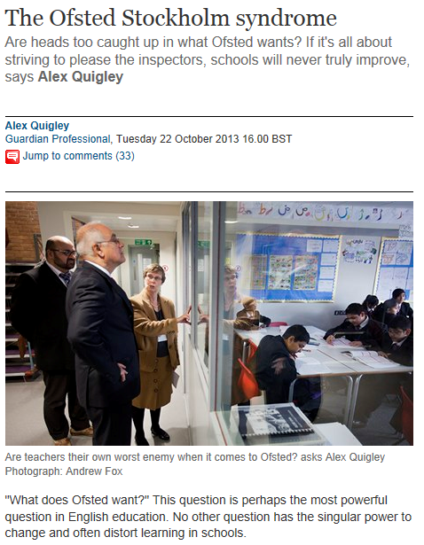
Notes:
28

Slide 29


Slide 30
Box 2. ‘The perfect Ofsted lesson’ Source: Marcella McCarthy, Jackie Beere, ‘The Perfect (OFSTED) lesson’ (https://www.tes.com/teaching-resource/planning-and-teaching-the-perfect-ofsted-lesson-6113548)

Slide 31
Evidence of side effects
  Chapman (2002, England):
  The promotion of a ‘low-risk culture’ was seen as a consequence of inspection outcomes.
Hardy (2012, England):
There was also a tendency for teachers to focus on students near pass/fail borderlines and to focus on practices to improve results rather than student learning overall.
Perryman (2002, England):
Ofsted designation of ‘special measures’ led to high staff turnover, pupil enrolment problems, funding and lack of (inexperienced) leadership.
Ferguson and Earley (1999, England)
The long period of anticipation led many heads to focus only on issues that they anticipated (recently: performativity as a result of no notice inspections)

Slide 32
Summing up
Effects of school inspections are varied and multidimensional! Differences for:
Type of schools (inspection category, leadership, student population, pedagogical concept)
Level in the school (governing body, head teacher, teacher, subject, pupil group)
Effects change over time (age of the Inspectorate, changes in educational system, experience and time in post of head teacher and teachers)
What makes Inspection Effective?

Slide 33
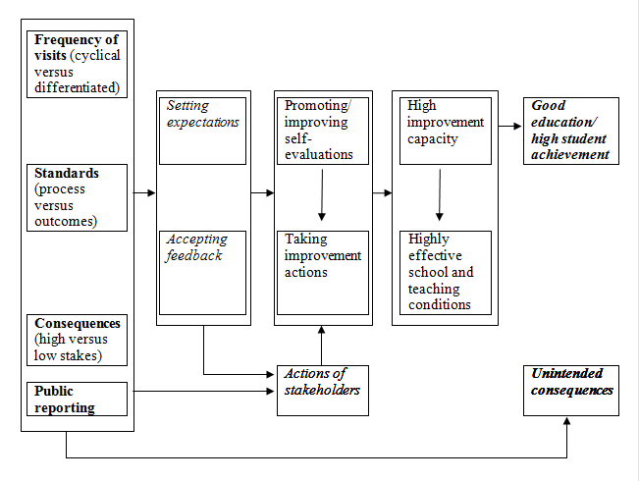

Notes:
33

Slide 34
Can school self-evaluation and external evaluation (inspection/high stakes testing) be effectively combined?
And how?
Parallel
Sequential
Cooperative
Notes:
34

Slide 35


Slide 36


Slide 37

m.ehren@ucl.ac.uk
www.educationalevaluation.net

